Slide 1
SunPower™ Solar Panels Reliability, Production, Efficiency, Sustainability
October, 2014

Slide 2
Legal Notice
The information presented on these slides is intended to be used in the form released.
Accordingly, Partner acknowledges that if Partner modifies, deletes part of, or otherwise revises the Presentation or any of its slides in any manner, in whole or in part, that Partner does so at its own risk.
Partner further acknowledges that if Partner does modify, delete or otherwise revise the Presentation, or any of its slides, that Partner is fully responsible for any objections, claims, or causes of action raised or filed by any third party against Partner and/or SunPower.
Partner also acknowledges that – if it modifies, deletes or otherwise revises the Presentation or any of its slides – SunPower shall not be liable for any direct, indirect or consequential loss or damages suffered by any person as a result of relying on any statement in or omission from this Presentation and that SunPower is released from any obligation to indemnify, defend, or hold Partner harmless under such circumstances.

Slide 3
SunPower solar panels are different.
SunPower solar panels are better.
Notes:
We have a challenge in selling SunPower panels, because they are more expensive than the Conventional Panels, and higher performing. This means we need to make it very clear why they are the best value, despite being a higher dollar-per-watt cost.
The additional efficiency is a key selling point for many buyers because they simply cannot get the desired amount of energy out of a small space without using high efficiency SunPower panels. But for the customers who have a choice whether to buy standard efficiency panels at a lower dollar-per-watt price, or high efficiency SunPower panels at a higher dollar-per-watt price, we still need to justify the higher dollar-per-watt price with clear added value.
That value comes in the form of higher energy production per watt, and higher reliability.
When selling SunPower panels, it is critical to first establish them as a fundamentally different solar panel. Many customers view all panels as the same – same design, same manufacturing practices and materials, same reliability, same energy production per watt, and same appearance. This is compounded by the fact that many system design tools used to determine the economics of a solar purchase do not reflect the performance of SunPower panels, which provide a significant economic return to our customers and more profit for our partners.
Another challenge is that most customers will hear from different panel manufacturers that the various Conventional solar panels are built with high quality materials, tested to the highest standards, etc., etc. In fact, this is how the leaders in Conventional solar panels try to differentiate themselves: better quality and reliability.
SunPower does a much higher degree of testing and quality control relative to Conventional Panel manufacturers, and uses better and more expensive materials, but it is NOT worthwhile to try to prove better quality and reliability based on these differences, because there are too many competitors claiming the same things. Customers have no way to know that SunPower is truly different based on those sorts of claims, and will be confused by the next sales pitch they hear. It’s just not effective.
The key way to avoid that pitfall is to FIRST show – beyond any doubt – that the SunPower panels are FUNDAMENTALLY DIFFERENT from the Conventional Panels. Only after that fact is firmly established can you can move forward and credibly state the reliability and energy production advantages.
This difference needs to be something that is obvious to everyone, including a lay-person end-customer, and inarguable by the Conventional Panel makers. It needs to be the primary reason for the differences in reliability and energy production.
They key difference of the SunPower panels is the Maxeon Solar cell …

Slide 4
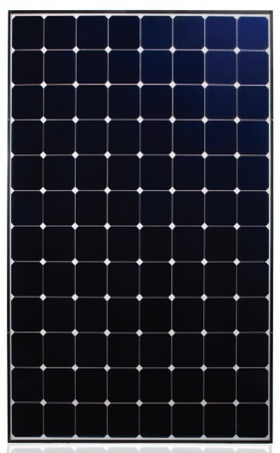
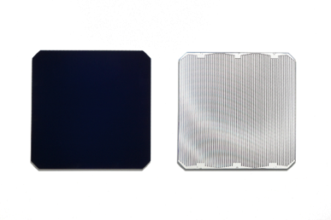
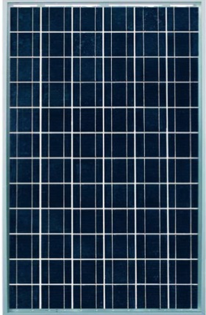
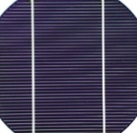
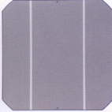
The Heart of the SunPower Panel is the Maxeon™ Solar Cell
The Maxeon cell has a fundamentally different design from a Conventional Cell: it’s built on a solid copper foundation
Copper plated solar cells cost more to manufacture than Conventional Cells, but the investment pays off with a much more reliable and high-performing solar cell.
SunPower starts with a tough, durable copper foundation – the Conventional Cells are made by baking a metal paste onto the silicon wafer – just like screen-printing a logo onto a T-shirt.¹
SunPower Panel with Maxeon
Conventional Panel (same size)
FRONT
BACK
FRONT
BACK
327-345W
240-260W
No metal
Copper-plated
Thin lines of metal paste
Full-coverage metal paste
¹ Definitions used throughout presentation: “Conventional Panel” is a 250W panel, 15.3% efficient, approx. 1.6 m², made with Conventional Cells. “Conventional Cells” are silicon cells that have many thin metal lines on the front and 2 or 3 interconnect ribbons soldered along the front and back.
Notes:
The Maxeon Solar Cell is the heart of the SunPower panel. As everyone understands, those cells produce far more energy in the same space. In the example shown here for two panels of the same size, the Gen 3 Maxeon solar cells which make up the X-Series panels are rated at 345W vs. the most common wattage rating for Conventional Panels: 250W (the average panel wattage of top conventional crystalline manufacturers from Photon and IHS). Also, the front-side is clearly different because there’s no metal grid-lines, and that provides the clean premium look associated with SunPower panels.
But the increased power output and the different appearance is not the fundamental difference which justifies the high reliability value of the SunPower panels. That difference is that the Maxeon solar cells are built on a SOLID COPPER FOUNDATION. This is absolutely unique in the solar industry, and in fact it costs SunPower considerably more to build cells on a solid copper foundation – the machines that do the plating process to create this foundation are each a football field in length.
The picture on the left shows the front of the Maxeon cell, with no metal at all. The interesting side is actually the back: it’s entirely covered with copper plating. That’s the foundation.
In contrast, the picture on the right shows a Conventional Panel. The metal on the front and back of the cell is not really metal at all – it’s a conductive paste that’s made of tiny bits of silver and aluminum that’s baked onto the silicon wafer. In fact the process of making those cells is the same as screen-printing a design on a tee-shirt: you create a template, wipe the paint across the template and the remove the template to leave the paint where you want it on the tee-shirt, and then bake the tee-shirt to cure the paint onto the fabric. This same screen-printing process is used to apply the thin lines of metal paste on the front, and the full-coverage metal paste on the back, to create a Conventional solar cell.
But unlike the strength and ductility of the solid copper foundation of the SunPower cell, the metal paste of the Conventional Cell offers NO strength to the thin silicon wafer, and as we’ll talk about soon, this fundamental design difference drives the big reliability advantages of the SunPower panels.
Note that the definition of a Conventional Panel: 15.3% efficient 250W panel that’s about 1.6 square meters in area … this is the primary work-horse of the industry.

Slide 5
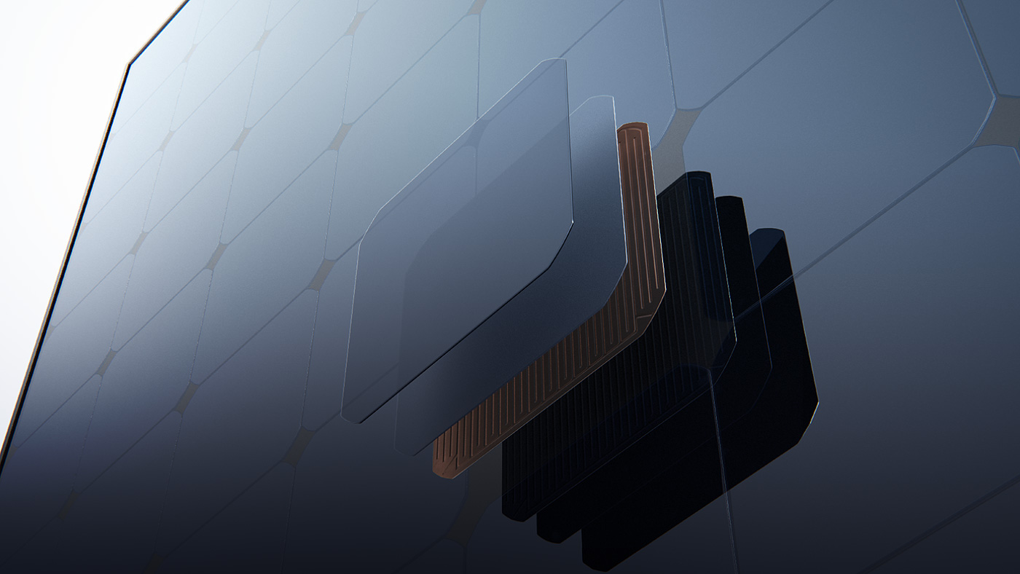
Maxeon Cells are Different
Notes:
The copper foundation is the inarguable and obvious difference we need to teach the customer, because it explains the better reliability of a SunPower panel.
The next section will explain how this difference results in reliability advantages.

Slide 6
Reliability

Slide 7
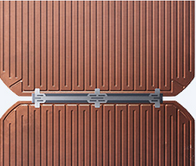
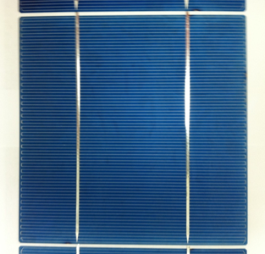
Maxeon Solar Cell Vs. Conventional Cell
Maxeon Solar Cell (Back)
Conventional Cell (Front)
Thick copper-plated foundation
Thin lines of baked-on metal paste
Strain-relieved copper bar connecting cell-to-cell
Soldered copper ribbons
Ribbons connect cell-to-cell
Thick copper (tin-plated) is robust against corrosion.
No soldering along the length of the cell
Copper bar connecting cells has robust copper-to-copper soldering, strain-relief, and double-redundancy.
Solid copper foundation maintains the cell energy production even if the silicon cracks.
Very thin screen-printed metal lines on the front of the cell are susceptible to corrosion over time
High-stress solder joints between the long copper ribbons and the crystal solar cell
As the panels get hot in the day and cold at night the copper expands but the silicon cell does not.
Over time, this repeated stress causes cells to crack and solder bonds to break.
Single points of failure on copper ribbons between cells.
Screen-printed metal paste has no strength to hold the cell together when the silicon cracks
Notes:
If you have example solar cells to show your customer, this is a good time to pull them out. You can point out each of the differences on the cells as you walk them through this slide. SunPower offers sales kits on the partner portal which contain SunPower and Conventional Cells for comparison.
The first difference to point out is that the entire back of the SunPower cell is the copper foundation. This thick copper is actually plated with tin and offers tremendous resilience to corrosion. Panels are made with a glass front, and with the solar cells encased in a tough clear plastic. Over the first few weeks of operation, water penetrates through the plastic and begins to corrode the metal on the solar cells. The key weakness for the Conventional Cell design is the very thin lines of metal paste on the front of the cell. These lines need to carry the electricity into the cell, but they are problematic because they are actually blocking the sunlight from hitting the silicon and making electricity. So to have decent power output, these lines need to be as thin as possible, and just big enough to carry the electricity. But as the water gradually corrodes those thin metal lines, the resistance of the solar panel goes up, it becomes harder to pass the electricity through the solar cells, and the power output goes down.
In contrast, the SunPower cell is designed with no metal on the front, and the entire back surface can be covered with a thick copper foundation, so no compromise needs to be made to have thin metal lines. This copper is actually plated with tin, to make it even further resistant to corrosion, and to make it easier to solder. Not only is there much less corrosion happening to the tin-plated copper compared with the silver-aluminum paste, but also there can be far more corrosion before there’s any change in the power output of the panel, since there is much more copper than what’s necessary to handle the electricity.
Interestingly, the reason for this design actually comes from SunPower’s heritage. When the company was founded in 1985, it was developing solar cells for concentrating solar systems: where mirrors and lenses were used to focus the sun down onto the silicon. That was why the metal needed to all be on the back of the cell, and that was why there is so much metal: concentrated sun creates much more electricity in the same sized silicon cell, and that means thicker metal is needed to carry that power. This design stayed over the years even as SunPower transitioned to the standard non-concentrating designs, and has resulted in this much more reliable solar cell.
The second difference to point out is how the electricity flows into, and out of, the silicon of the cell. For SunPower, the electricity is transported to every part of the cell from the copper foundation which covers the entire back of the cell and gets the electricity in and out of the silicon.
In contrast, the Conventional Cell has a much more challenging task. The electricity is carried to the silicon through two thin copper ribbons which can be seen as the larger shiny silver bars in the picture on the right. These copper ribbons need to be soldered onto two strips of metal paste which extend all the way along the length of the Conventional Cell, both top and bottom. This is a very challenging solder process, since it’s soldering the copper ribbons onto the metal paste which has been baked into the silicon.
But the big challenge for the Conventional design comes from what’s called “thermal expansion.” When you mount a solar panel on your roof, it goes from being as cold as the night-time air every night, to being as hot as a black roof on a sunny day. That’s often a swing from 50F to 150F every day. The challenge comes because the copper ribbon wants to get longer when it’s hot, and shorter when it’s cold … but the silicon cell that it’s soldered onto hardly changes in size as the temperature changes. That creates a daily push-and-pull cycle which focuses tremendous stress on the solder connection between the copper ribbon and the silicon cell. Over time this repeated push-pull cycling causes the solder bond to break or the silicon cell to crack. When this happens, the electricity can no longer flow through the solar cells in the panel, and the power is severely reduced.
[Occasional question from a technical customer: “if the SunPower cell is covered in copper, then why isn’t that under the same push-pull stress as the Conventional Cell?” Answer: The key is that the SunPower cell distributes that stress through the entire area of the cell, so it’s never very high. The problem with the Conventional Cell design is that the stress is all concentrated into the small solder connection between the ribbon and the silicon. It’s like the difference between the amount of pressure that a floor needs to withstand when there’s someone standing with boots on, compared with someone standing with pointed high-heels … the high-heels concentrate all the weight onto a small spot, which causes a much higher level of stress.]
The third difference to point out is how the electricity gets from one cell to the next. A solar panel is very much like a stack of batteries: the electricity (really the “current”) goes from cell to cell, and each cell contributes about half a volt. By wiring a string of several solar panels together on the roof, you’re essentially creating a stack of about 600 to 1000 solar cells, and that creates the 300-500 volts of electricity that your system generates. BUT every single cell needs to have that electricity pass through it for the system to work, and that means the connection from one cell to the next cell is critical.
The SunPower design accomplishes this with what we affectionately call the “dog-bone.” It’s a solid copper bar you can see in the bottom of the left picture. There are three solder pads which take the electricity from the lower cell at the bottom of the picture, bring it onto the dog-bone, and then three solder pads to send the electricity into the next cell, which is the middle of the picture. The solder connection from the copper bar to the copper foundation is the most common and robust connection in the electronics industry: tin-plated copper soldered to tin-plated copper. And the three pads offer double-redundancy. If the solder connection under one, or even two, of those pads is broken, the electricity can still flow through the third pad. Note also that there are holes in the dog-bone near the solder pads. Those holes allow the cells to move around more easily without stressing the solder connections, since the push-pull of the temperature cycles can also make the cells move with respect to each other.
In contrast, the Conventional Cell has two narrow copper ribbons which carry the electricity from the top of one cell to the bottom of the next cell. In between cells, all the stress from cell-to-cell movement is focused on those copper ribbons. And when one breaks, there’s no redundancy in the design – part of the cell will no longer be able to pass the electricity.
The fourth and final difference between the SunPower Maxeon cell design and the Conventional Cell design which causes big differences in reliability is what happens when the silicon cracks. Silicon is a very brittle material, and solar cells are essentially extremely thin glass wafers – only 200 microns – double the width of a human hair. So they crack fairly easily from the stresses from temperature cycling and the push-pull from the copper ribbons. They can also crack during shipping and installation, or during big storms or impacts, or when someone is walking on panels (which is a bad idea).
Because the SunPower Maxeon cell is entirely covered on the back with the copper foundation that brings the electricity into and back out of every part of the silicon, the cracks in the silicon have very little effect. They lower the power output of the silicon in the area extremely close to the crack, but the rest of the silicon remains a part of the electrical path because it’s connected to the foundation. The copper foundation does not crack because the copper is very flexible and ductile (the opposite of the brittle silicon wafer). Because all the silicon remains connected to the electrical circuit that carries all the electricity, there is almost no power loss from cracks in cell.
In contrast, cracked silicon in Conventional Cells can cause large areas of the silicon to no longer be connected to the electrical circuit. Any time an area of silicon is not connected through a line of metal paste to the copper ribbons that bring electricity from cell-to-cell, that area of silicon is no longer part of the circuit, and is essentially dead. This happens frequently when a cell is cracked, because the metal paste offers zero strength to hold cracked silicon pieces together – it’s like a conductive paint. And when the broken part of the silicon separates by even a nanometer, the electrical connection through the metal paste is lost and the cell has dead areas. This results in very significant power loss.
[For more technical customers, you can further explain that a solar system is also like a string of batteries, whereby each battery needs to deliver the same current to have the most power output, and one bad battery in a string of good batteries will bring down the performance of the entire string to the level of the bad battery because it can’t deliver the same current. What happens in a solar panel is that a cell with significant cracked dead areas cannot keep up with the amount of electricity of the rest of the cells, and the electricity will need to flow through the bypass diode. Since there are 3 bypass diodes per panel, each protecting one third of the cells from this situation, a full third of the power output from a panel will be lost from a single cracked cell that has too much dead area – the electricity will have to go through the bypass diode rather than the solar cells.]
So now I’ve shown you how the fundamentally different design of the Maxeon cell – the copper foundation – results in a much more durable cell. Like the electric car that doesn’t have any piston rings or muffler to fail, the Maxeon cell has designed out the failure modes associated with copper ribbons soldered to silicon with baked-on metal paste.
Next we’ll tie this theoretical understanding into real-world examples and test results.

Slide 8
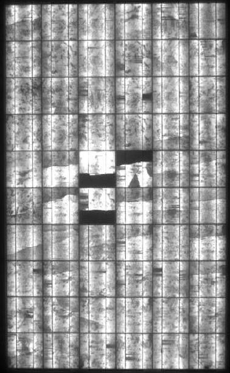
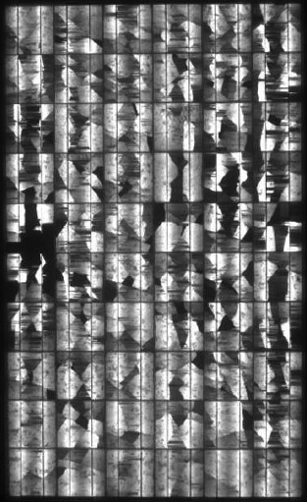
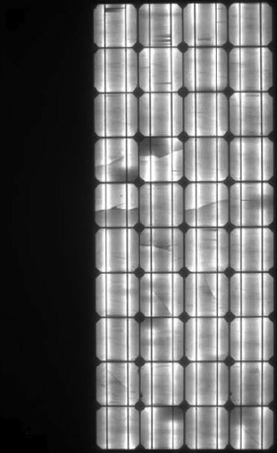
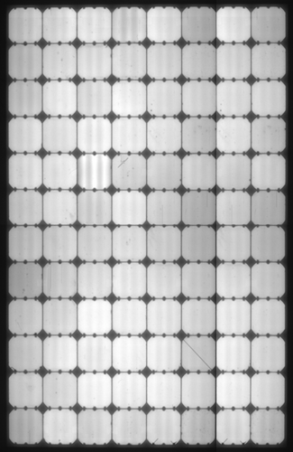
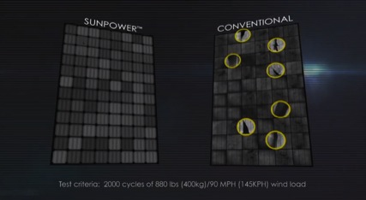
Cracked Standard Efficiency Cells in the Field
Conventional Panels
SunPower Panel
Black areas = No Power
Likely damaged in installation or from repeated hot/cold temp cycles
Likely damaged from poor soldering process and hot/cold temp cycles.
Left side has broken copper ribbons between a pair of cells.
Even with a crack, all parts of the cell are running (no black).
2 MINUTE VIDEO ABOUT CELL CRACKING
Conventional Panels commonly fail from hot/cold temperature cycles that crack solar cells, solder joints and copper ribbons over time.
Notes:
So what happens in the real world? This cell cracking is very common.
Here are three examples of Conventional Panels with cracked cells. These pictures are electro-luminance images - the black areas of the panels are ‘dead’ and not producing any power.
In the image on the left, the 3 cells in the middle have cracked cells where large portions of the cells are black – meaning they are not connected to the electrical circuit of the panel. This is most likely from temperature-cycling over time, but could also have happened during installation or shipping or a storm. When this panel runs, those cells will not be able to keep up with the electricity generation of the other cells, since they are effectively much smaller, and the bypass diode will kick on to bypass the 3rd and 4th column of cells – resulting in a 33% loss of power output. It’s actually lucky that it’s not the 2nd and 3rd column, since that would turn on two bypass diodes and cause a 66% reduction in power output.
The middle Conventional Panel shows widespread damage indicating poor quality soldering between the cells. This is a situation where too much stress was built into the original solder bond between the copper ribbon and the silicon cell, and although the panels were fine when they were new, the repeated thermal cycles has caused almost every single cell to crack. This panel is about 5 years old.
In the right Conventional Panel image, the copper ribbons between two cells in the left third of the panel have broken completely, causing that third of the panel to be completely dead – no electricity can pass through because it’s an open-circuit. Because the panel has bypass diodes, the remaining sections are able to continue to produce, so this panel is 33% down in power output. With continued temperature cycling stress, the copper ribbons in these sections will likely also crack over time.
The image at the right shows a SunPower panel with a cracked cell. As you now know, the copper foundation behind the Maxeon cells means that the cells are not likely to crack because there’s much less temperature cycling stress, but even if they do crack, it doesn’t matter because all the silicon remains connected to the rest of the electrical circuit and there’s almost no impact on the power production. You can see in the image that there are no “dead” areas of the cracked cell, since all the silicon is still connected to the copper foundation.

Slide 9
Common Ways Conventional Panels Degrade
Corrosion
45.3%
Cell or Interconnect Breaks
40.7%
Wohlgemuth, J. “Reliability of PV Systems.” Proceedings of SPIE, Aug, 2008.
Notes:
So how important is cell cracking and breaking of the copper ribbons? Does it really happen a lot?
In a large study of many solar panel manufacturers by John Wohlgemuth – widely considered the father of Solar Panel reliability (he works at NREL – the National Renewable Energy Lab in Colorado, and has been researching solar since the 70s) – he shows that Cell or Interconnect Breakage is a leading cause of solar panel degradation and failure, as well as Corrosion.
It’s critically important for high reliability to eliminate these failure modes, and that’s exactly what the Maxeon cells do. We’ll start with Cell or Interconnect Breakage test results …

Slide 10
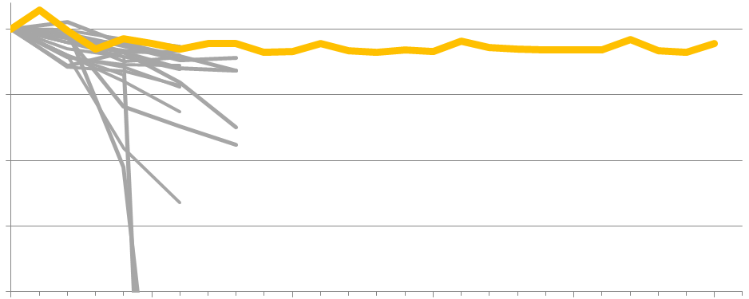
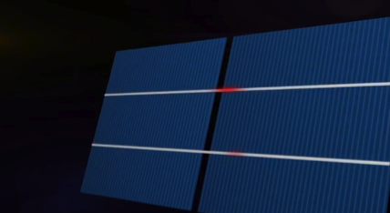
Unmatched Reliability: Unique Maxeon Design
No cell-to-cell interconnect breakage
Cell cracks have essentially no impact on energy output
100%
SunPower
Conventional Panels^{1,2}
95%
Panel Power
90%
85%
Certification Standard 200 Cycles
80%
2 MINUTE VIDEO ABOUT THERMAL CYCLING
0
500
1000
1500
2000
2500
Number of Cycles: -40 to 85°C (-40 to 185°F), 5 cycles per day
The unique design of the Maxeon cell makes the panels almost impervious to hot/cold temperature cycles.
¹ Koehl, Michael, et. al. “PV Reliability: Accelerated Aging Tests and Modeling of Degradation.” Fraunhofer ISE and TUV Rheinland. Presented at EUPVSEC, Valencia Spain, Sept 2010.
² Meakin, D. H. , et. al (2013). Fraunhofer PV Durability Initiative for Solar Modules. PV International, 77–87.
Notes:
This is proof from lab tests that the SunPower panels are uniquely impervious to the stresses from hot-and-cold temperature cycling which cause Conventional Panels to degrade from broken cells, broken solder connections, and broken copper ribbons between cells.
It’s an accelerated test – meaning that in order to represent 1000s of real day-and-night roof temperature swings of perhaps 100F, the test does 5 swings per day from -40F to 185F … a 225 degree temperature swing.
As you can see from the chart, the Conventional Panels are starting to degrade almost right away, and are significantly degraded after 800 cycles, while the SunPower panels are unaffected, even after 2500 cycles.
It’s worth discussing the certification standard, since many manufacturers use the certification standard as a proxy for having good reliability. The certification standard was developed only as a minimum threshold to prevent dangerous electrical products from entering the consumer market. Think about the UL stamp on almost all your electronic devices at home, for example. The panel certifications were never intended to indicate anything about long-term reliability or quality, and it should not be used that way.

Slide 11
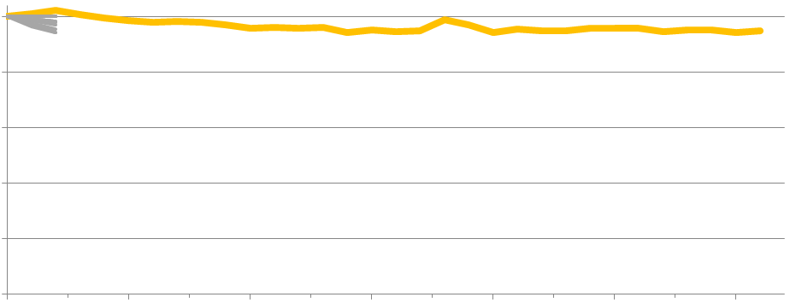
Unmatched Reliability: Unique Maxeon Design
No “many-cycle” Conventional Panel data is available for comparison for the world’s most challenging accelerated test: cycles of hot-and-humid followed by rapid freezing.
The certification standard of 10 cycles has a failure rate exceeding 10%¹. SunPower panels are almost unaffected after 310 cycles.
100%
SunPower
90%
Conventional Panels^{1,2}
80%
For certification testing: “The top 4 failure rates for c-Si panels were related to damp heat, thermal cycling, humidity freeze and diode tests.”¹
Panel Power
70%
60%
Certification Standard 10 Cycles
50%
200
0
50
100
150
250
300
Number of Cycles: -40 to 85°C (-40 to 185°F) with ice and humidity, 1 cycle per day
The unique design of the Maxeon cell makes the Panels almost impervious to water-freezing cycles.
1 TamizhMani, B. G. “Failure Analysis of Module Design Qualification Testing – III,” 36th IEEE PVSC Conf, 2010
2 Jones, J., & Shiao, M. (2014). PV Module Reliability Scorecard.
Notes:
This is a similar test, only even more brutal, and we could find no extended-testing data on Conventional Panels to plot with the SunPower results, other than to note that more than 10% of panels fail the 10-cycle threshold of the certification standard (meaning a larger-than-5% power drop after just 10 cycles).
These panels do the same 225F temperature swing, but on top of the temperature, the hot part of the cycle at 185F is done with high humidity (85%). That drives water into the panel, and then when it goes through the cold part of the cycle at -40F, that water freezes and the ice expands and blows apart anything it can. This is the cycle that destroys roads during the winter, for example.
Again you can see there’s essentially no impact from this stress on SunPower panels, even after 310 cycles (31 times what’s required for certification). Conventional Panels typically are in bad shape after about 20 cycles.
The fundamentally different design of the Maxeon cell has eliminated this very important failure mode.
It’s also worth noting also that the current SunPower panels are about twice as good as the previous panels.

Slide 12
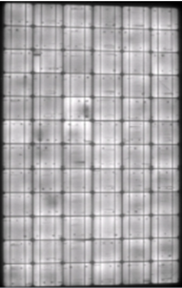
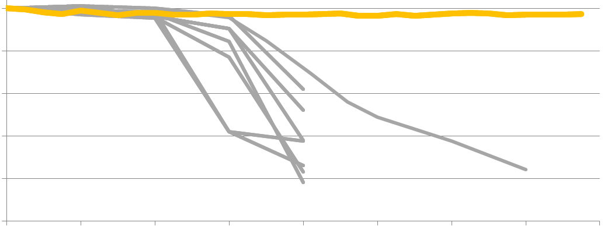
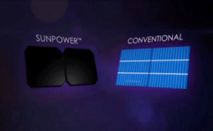
Unmatched Reliability: Unique Maxeon Design
Conventional Panel
Tin-plated copper foundation does not corrode
SunPower
Conventional Panels^{1,2}
100%
80%
Metal Corrosion
60%
Panel Power
40%
20%
Certification Standard 1000 Hours
30% Power loss at 3000 hours³
0%
Dark = Low Power
0
1000
2000
3000
4000
5000
6000
7000
8000
Number of Hours at 85°C (185°F) and 85% Humidity
1 Koehl, Michael, et. al. “PV Reliability: Accelerated Aging Tests and Modeling of Degradation.” EU PVSEC, Valencia Spain, Sept 2010.
2 Ketola, B., & Norris, A. Degradation Mechanism Investigation of Extended Damp Heat Aged PV Modules. EUPVSEC, 26th, Hamburg, Germany, 2011
3 Jahn, U. PV Module Reliability Issues Including Testing And Certification. 27th EUPVSEC, 2012.
The unique design of the Maxeon cell makes the Panels almost impervious to corrosion.
2 MINUTE VIDEO ABOUT HUMIDITY TESTING
Notes:
If you remember from the chart, the single biggest cause of degradation and death of Conventional Panels is Corrosion . The heavy tin-plated copper foundation of the Maxeon cell, however, makes them much less susceptible to the corrosion that attacks the thin lines of metal paste on the front of a Conventional solar cell.
So how do SunPower panels do in accelerated testing? …
Here you can see the test designed to accelerate corrosion. It’s putting the Panels in a chamber that’s at 185F and 85% relative humidity for many hours.
You can clearly see the corrosion kicking in for the Conventional Panels studied by Michael Koehl at Fraunhofer in Germany. They average 50% power after 4000 hours in the chamber. The images on the right tell the story. (Blacker areas are lower power.) The upper panel shows the starting point, and the lower panel shows how the cells have degraded from the corrosion – especially around the edges where water gets in more quickly.
As expected from the copper foundation design, the SunPower panels show very little degradation, even after almost a year of time in the chamber. In fact, they are almost completely unaffected by this tremendous heat and humidity.
I’m often asked how many hours in this test corresponds to 20 years in the real world. That is a difficult question because it depends on the failure modes of the specific materials being used, and the climate. Michael Kempe from the National Renewable Energy Lab in Colorado studied this question and determined that 20 years corresponds to 2000 to 3700 hours in this test (1), for a hot and wet climate. Survival of a Conventional Panel for the 25 year warranty depends critically on the materials used to make the panel, and will be a big problem for some manufacturers.
¹ Kempe, Michael, et al. “Modeling the Ranges of Stresses for Different Climates/Applications,” Int. PV Module QA Forum, San Francisco, 2011.

Slide 13
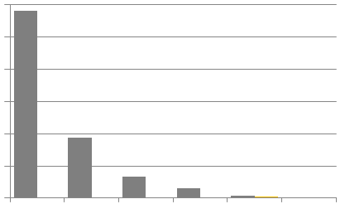
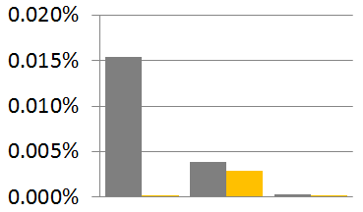
Unmatched Reliability: Unique Maxeon Design
Panel Return Rates¹
0.30%
0.02%
0.25%
0.01%
SunPower Maxeon II
8.45M panels (2.1yr avg. age)
0.005% returns
0.20%
0.00%
0.15%
Hot Cells/ Brown Cells
Glass Breakage
Junction-box/Cables/ Diode Failure
Conventional Panels SunPower services 740MW of Conventional Panels from purchasing two other companies
PV System Installer
20 Manufacturers
850,000 panels (7yr avg. age)
0.87% returns
European Manufacturer
2,600,000 panels (4yr avg. age)
0.15% returns
0.10%
0.05%
0.00%
Unknown
Backsheet or Encapsulant Delamination
Cell Interconnection Breakage/Cell racking/ Soldering Breakage
SunPower panels have a very low return rate.
1 Hasselbrink, E., et al. Validation of the PVLife Model Against 3 Million Module-Years of Live Site Data. 39th IEEE PVSC, Tampa Florida, 2013.
Notes:
While accelerated lab tests are useful to compare panel technologies in specific stresses, statistics on actual field performance provide a comparison of panels under complex and combined stresses. This slide shows the SunPower vs. Conventional Panel return rates, broken out by how the panels failed.
There are two conclusions to draw from this slide:
The biggest failure mode of Conventional Panels has been essentially eliminated by the unique design of the Maxeon solar cell. Cell interconnections (ribbons, soldering, etc) dominate the returns for Conventional Panels – more than 1000 times larger than cell interconnection returns for SunPower panels.
2. The return rate of the SunPower panels is far lower than Conventional Panels.
Comparisons of return rates across different panel types are hard to find because other manufacturers make accurate panel warranty return data a well-kept secret. But SunPower is in the unique position of having purchased two companies which deployed front-contact panels.
PowerLight was an installation company which did 240MW of panels from 20 different manufacturers before it was bought by SunPower. The return rate is almost 1%, at about 1 panel out of every 115 being returned.
More recently, SunPower acquired Tenesol, a high quality front-contact panel manufacturer based in France. They were known for high quality panels: good materials, fully automated processing and good European quality processes. They have 500MW of panels in the field, and the return rate is 0.15% … one panel out of 650 being returned.
SunPower’s return rate is 0.005% … only one panel per 20,000 returned!
[Customer question: “but the SunPower panels are not as old as the Conventional Panels … does that matter?” Answer: That doesn’t account for such a big difference, since the returns per year are expected to be steady (the panels are all early in their expected lifetime). If you compare returns per year, the Conventional Panels are running at over 25 times the annual return rate of SunPower panels.]
[A customer very familiar with SunPower might ask about Serengeti Panels, which were Conventional Panels that were manufactured and sold by SunPower, primarily in 2011. They have not been deployed long enough to have meaningful return statistics compiled.]

Slide 14
Global Quality Survey
IHS is a 50 year old company that provides critical information to key decision makers
Global EPC and system integrators, distributors, and installers were surveyed on buying preferences, brands, and panel suppliers.
These experts from over 30 countries rated SunPower¹
#1 in Panel Quality
#1 Most Requested Brand
Module reliability and high quality were ranked as the two most important attributes when selecting a panel
SunPower is globally recognized as a quality leader by industry experts
1 Gilligan, C., et al. 2014 PV Module Customer Insight Survey. IHS Consulting.
All trademarks or logos are the properties of their respective owners.
Notes:
IHS conducted a global survey of PV experts, such as system integrators and developers, which attributes are most important when selecting a panel.
It is not surprising that module reliability and high quality were the top ranked attributes, since these characteristics lower project execution risk and ensure long term return on investment.
SunPower was voted as #1 in panel quality and the market clearly recognizes this advantage, as SunPower is also the most requested brand.
[Savvy customer might ask: Who is #1 in reliability? Answer: This question was not in the survey.]

Slide 15
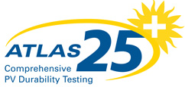
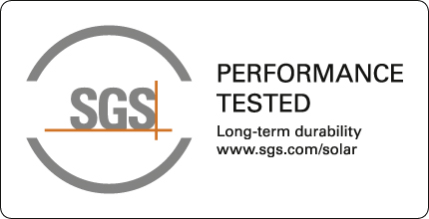
Third-Party Reliability Testing
Atlas, a subsidiary of Ametek, has been the leader in durability testing of materials for more than 90 years, and developed the “Atlas 25+ Comprehensive PV Durability Testing Certificate”
This testing also qualified for the “SGS Performance Tested” Certificate.
3 panels tested per manufacturer: Salt Spray Corrosion, Humidity-Freeze cycling, Solar-Thermal Humidity-Freeze Cycling.
SunPower earned the toughest certificate, with an average power drop of 0% across all panels¹
1 Atlas 25+ Certificate, Apr 2013. 0% power drop relative to the non-stress-tested control panel.
All trademarks or logos are the properties of their respective owners.
Notes:
A number of product test labs have created stress test protocols to rank panels by how durable they are. These tests are not nearly as stringent as what SunPower does with internal testing, and because of the challenges in accelerated testing of real-world conditions (ultra-violet light + temperature cycles + humidity + voltage, all at the same time) the test results are not clearly correlated to estimates of real panel lifetimes in different conditions.
BUT they do provide a useful way to compare the durability of various panels.
SunPower participated in the Atlas 25+ program by Ametek, which has been a leader in materials durability testing for over 90 years, and has been doing this year-long test protocol every year since 2010. The test is done in compliance with SGS, the world’s leading inspection and certification company with more than 70,000 employees, so SunPower has also earned the “SGS - PV Performance Tested” certificate.
Because this is a certificate, there is no rank or information about how other panels did. SunPower did their toughest test regimen, however, and attained their highest certification level, and had an average power drop of 0% for the tested panels compared with the untested control panel. Zero percent! The panels were unaffected by all those tests!

Slide 16
Third-Party Reliability Testing
Fraunhofer is one of the world’s largest organizations for applied research, with a staff of more than 20,000 people and an annual research budget exceeding $2 billion. It is world-renowned for its expertise in solar power technology.
Fraunhofer CSE selected 5 of the top 8 silicon PV manufacturers’ panels to rank based on their reliability … SunPower and 4 others (anonymous to participants)
20 panels per manufacturer were purchased directly by Fraunhofer either from distributors or on the open market
The PDVI Test Protocol included: PID testing (damp heat exposure with bias), temperature cycling, humidity-freeze cycling, ultra-violet light exposure, static and cyclic mechanical load testing
In 2013, three more panels were tested - SunPower maintained its leadership with 6 times less power loss²
Manufacturer | Average Power Drop | Max Power Drop
SunPower | 1.3% | 2.3%
Four out of the top eight crystalline silicon panel manufacturers in 2012 (SunTech, Yingli, Trina, Canadian Solar, Sharp, Hanwha SolarOne, Kyocera) Three anonymous panels in 2013. | 7.8% | 94%
1 Meakin, D. H., et al. (2013). Fraunhofer PV Durability Initiative for Solar Modules. Photovoltaics International, 77–87.
2 Ferrara, C., et al. (2014). Fraunhofer PV Durability Initiative for solar modules: Part 2. Photovoltaics International, 77–85.
All trademarks or logos are the properties of their respective owners.
SunPower panels came out #1, with an average power drop of 1.3% across all panels¹
Notes:
SunPower participated in another study by Fraunhofer, a large European-based research institution with over 20,000 employees – world-renowned for its expertise in solar power technology. They developed a very rigorous series of tests that stand out in a couple ways: they run a large number of panels – 20 of them – through a lot of different stress tests, and they get the panels for testing from the open market and not directly from manufacturers, which means manufacturers can’t send pre-screen their panels before sending them to be tested.
They started this test protocol at the beginning of 2012 (it takes about 1 year to complete), and tested 5 out of the top 8 panel manufacturers (according to 2011 MW shipped). That list includes SunPower, and we don’t know the other participants because the results are shared with the participants, but anonymous except for our own panel results. But we do know the other participants are 4 from the remaining top 7, and First Solar wasn’t tested since they only do thin-film panels … so that leaves six contenders: SunTech, Yingli, Trina, Canadian Solar, Sharp, and Hanwha SolarOne.
In 2013, the program was repeated with three additional Conventional Panels. On average, the newer panels degraded more than the 2012 batch due to worse performance in PID and mechanical load testing.
SunPower panels came out #1, with an average power drop of 1.3% across all panels. The average power drop of all the Conventional Panels was 7.8% … more than 5x higher, which is surprisingly consistent with the degradation rate difference between SunPower and Conventional Panels which we’ll discuss shortly.
SunPower’s most degraded panel dropped by 2.3% power, while the Conventional Panels showed a much wider variation, with as much as 94% degradation. These points underline that the Maxeon SunPower cell’s copper foundation is much more durable design, and also that it’s challenging to get consistent reliability from Conventional Panels just because of the way they are designed and built.

Slide 17
Third-Party Reliability Testing
PV Evolution Labs is an independent testing lab specialized in performance and characterization testing on PV panels owned by the independent engineering firm, DNV-GL.
The Potential Induced Degradation Certification Program tests a panel’s susceptibility to voltage stress, which can cause rapid power loss.
Panels were tested at maximum voltage rating in all grounding configurations.
SunPower panels degraded negligibly during this test.
Manufacturer | Pass Rate | Average Power Drop
SunPower | 100% | 0.2%
Conventional Panels | 50% | 4-5% for panels that passed the test
SunPower panels are exceptionally resilient against PID in any grounding configuration.
1 Based on independent testing and analysis performed by PV Evolution Labs in 2013. To pass, panels must have less than 5% power loss at 100 hours and 10% power loss at 600 hours.
All trademarks or logos are the properties of their respective owners.
Notes:
Potential Induced Degradation, or PID, is power loss caused by electrical stress between the cells. A voltage between the cells, across the glass, and to the frame causes migration of ions, rearranging the solar cell on an atomic scale. In hot and humid environments, this stress is accelerated. The heat increases ion migration, while the humidity gives a better path from the cells to the grounded frame, further accelerating the phenomenon. PID can easily cause 30% power loss in Conventional Panels.
Because PID is a complicated phenomenon, requiring deep knowledge of chemistry and physics, testing standards are still being developed. The test and PV Evolution Labs is especially thorough. When compared to the draft IEC standard, it is has a 6x longer test duration and vastly higher temperature and humidity. In fact, it is so stringent that only 50% of the Conventional Panels submitted have passed the pest. The remaining ones that did pass had 4-5% power loss. SunPower panels degraded 20x less, with an average power loss of only 0.2%.
This test shows that SunPower panels are PID free in all grounding configurations.

Slide 18
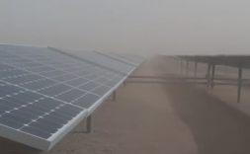
Third-Party Reliability Testing
TÜV is a 130 year old organization founded in Germany and is recognized as global leader in validating the safety of products and determining their robustness against environmental hazards.
Desert conditions present harsh stresses:
Intense UV exposure breaks down materials
Blowing sand and dust erode surfaces
Fine dust infiltrates seals and connectors
TÜV’s Sandstorm Testing is based on military and IEC specifications for desert environments and goes well beyond conventional panel certification programs. For example:
UV dosage is 8x IEC requirement
Quartz particles are shot at 108 kph (67 mph) against the panel surfaces
SunPower is the first and only manufacturer to pass this stringent test.1
15 SECOND VIDEO OF PANELS IN A SAND STORM
SunPower panels are robust against state of the art desert stress tests
1 “SunPower Successfully Passes TÜV Rheinland’s Rigorous Sand and Dust Testing”. TÜV press release. May-14.
All trademarks or logos are the properties of their respective owners.
Notes:
Deserts are especially tough environments for most solar panels. Intense UV radiation breaks down polymers which hold a panel together, while constant wind blows particles (which erode surfaces) and fine dust (which infiltrates seals and connectors). TUV developed a stringent desert test program, which pulls from military and environmental exposure test standards. This test is intended to simulate harsh desert conditions and probe for weak points in panel design.
SunPower is the first manufacturer to pass this program, demonstrating the robustness of its panels in harsh desert climates.

Slide 19
Third-Party Studies: Lower Degradation Rate
National Renewable Energy Lab (NREL) has been measuring SunPower panel degradation in Colorado since May 2007: -0.10%/yr.
Large research studies of Conventional Panels indicate a degradation rate of approximately -1.0%/yr.
SunPower NREL¹
M Vasquez⁶
T Sample²
D Jordan³
A Suleske⁴
S Pulver⁵
0.00%
-0.25%
-0.50%
Annual Power Degradation
-0.75%
Average Conventional Panel degradation rate = 1.0%/year
-1.00%
-1.25%
1 Jordan, Dirk “SunPower Test Report,” National Renewable Energy Laboratory, June 2014
2 Sample, T. “Failure modes and degradation rates from field-aged crystalline,” Feb 2011
3 Jordan, D., et al. “Photovoltaic Degradation Rates – an Analytical Review,” Progress in Photovoltaics. Jan 2013. Vol 21, p 12-29. Average degradation rate show in plot.
4 Suleske, A. “Performance Degradation of Grid-Tied Photovoltaic Modules in a Desert Climatic Condition,” Nov, 2010.
5 Pulver, S. “Measuring Degradation Rates without Irradiance Data” Jun, 2010
6 Vazquez, M. “Photovoltaic Module Reliability” 2008
-1.50%
Lower degradation = more energy over the life of the system
Notes:
The accelerated testing we looked at are great for indicating the durability of the products over the long term, and we expect to see that backed-up with field data.
This chart shows a couple strings of SunPower panels which have been in operation since May of 2007 in Colorado. They are regularly measured by NREL (National Renewable Energy Lab) with very high quality equipment and show -0.10% per year degradation.
Also on the chart are 5 large studies of the degradation of Conventional Panels. Each study gives average degradations across a wide swath of different panels, and they indicate a range of about -0.75% per year to -1.25% per year for a typical degradation rate of Conventional Panels. SunPower generally uses -1% per year for the degradation rate of Conventional Panels.
The difference in degradation rates, due to the fundamental design differences, is clear from these field results.

Slide 20
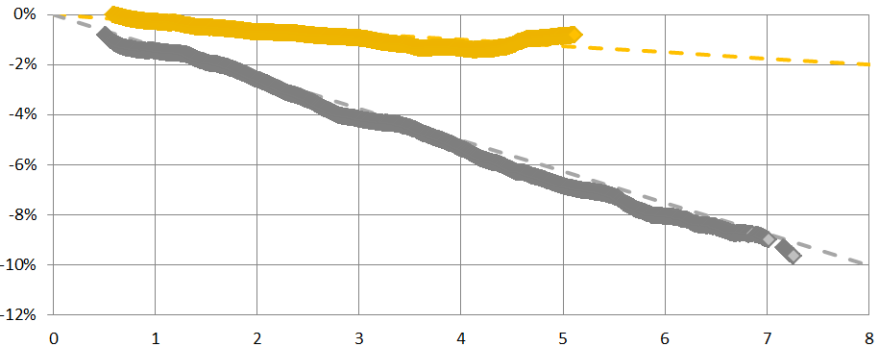
System-Level Degradation from Field Data
The most comprehensive degradation study ever done: more than 800,000 panels from over 400 monitored inverters across 144 sites, for time spans averaging 6 years.
SunPower systems: 86MW, age 3.5-7.5 years
Non-SP systems: 42MW, age 4.5-13.5 years
SunPower degradation rate affirmed by Black & Veatch¹, one of the most experienced Independent Engineering firms in solar power plants, with over 2,000 MW of utility scale projects
SunPower -0.25%/year
SunPower Solar Fields
System Level (AC) Degradation
Conventional Solar Fields
Conventional -1.25%/year
1 Romero, Ralph, et al. “Review of SunPower Fleet-Wide System Degradation Study using Year -over-Year Performance Index Analysis,” Black & Veatch Eng., Nov. 2012. Updated values Sep. 2014.
System Age (years)
Notes:
SunPower is in a unique position in the solar industry because it builds and then deploys its own panels, but it also bought PowerLight, a company which installed panels from 20 different manufacturers. Many of these installations are still under O&M agreements and their performance is being monitored.
This unique and massive data set has enabled SunPower to do the most comprehensive degradation study ever completed – with 86 MW of SunPower panels and 42 MW of non-SunPower panels, across 144 different sites, for time spans averaging about 6 years.
Every monitored site was included in the study without regard to how it was performing, and all sites were put through exactly the same numerical analysis to arrive at the median degradation rates spanning all the sites for both SunPower and non-SunPower panels. The result: our previous generation panels are losing power at the rate of -0.32% per year. (Note that the current generation panels do not have enough years of time in the field to be able to analyze, but they are about twice as good based on the accelerated test results and quantitative computation modeling of degradation modes.)
The Conventional Panels – treated in exactly the same way – show a degradation rate that’s four times worse: -1.25% per year. That’s in-line, however, with most industry studies, which range from -0.7%/yr to -1.45%/yr.
One might wonder if past Conventional panel performance is indicative of what’s being sold today, since usually technology improves over time. Unfortunately, IEC testing failure records, such as those published by TamizhMani² from the IEC test lab in Arizona, indicate no trend toward more reliable panels over the past 15 years. This is because the strong cost pressure has driven many manufacturers to lower-cost materials, and they use the certification tests as their proxy for reliability testing.
We had an Independent Engineering firm, Black & Veatch, audit our analysis. They are one of the most experienced Independent Engineering firms in solar power plants, with over 2,000 MW of utility scale projects. They found our approach to be sound, and they supported the conclusion that SunPower panels are -0.32% per year, based on all the field data.
(² TamizhMani, B. G. “Failure Analysis of Module Design Qualification Testing – III,” 36th IEEE PVSC Conf, 2010)

Slide 21
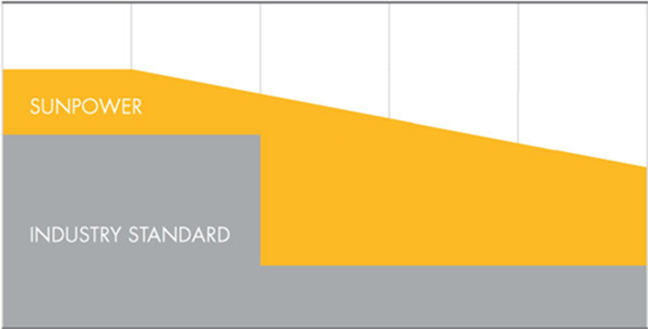
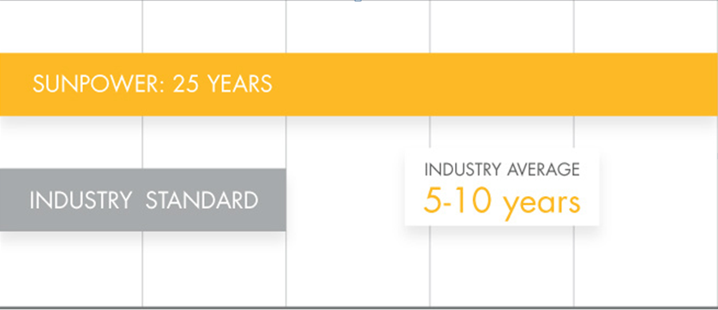
Durable Maxeon Cell Design Allows SunPower to Offer the Best Combined Power and Product Warranty
Because of the excellent reliability of the Maxeon cell, SunPower can deliver:
Only 25 year Combined Product and Power Warranty on all products
Lowest Guaranteed degradation rate: -0.4%/yr¹
Replacement costs are covered²
Power Warranty
Product Warranty
100%
95%
90%
Nameplate Power
85%
80%
75%
0
5
10
15
20
25
0
5
10
15
20
25
YEARS
YEARS
Best available Conventional Panel “linear” warranty
1 Compared with the top 15 manufacturers. SunPower Warranty Review, Feb 2013.
2 Some restrictions apply. See warranty for details
Notes:
Because of the durability of the Maxeon cells, the track-record of low returns, and the low field degradation, SunPower re-wrote the book on panel warranties in 2012.
The SunPower combined power and product warranty guarantees more than 95% of the minimum rated power output for the first 5 years, and then dropping less than 0.4% per year for the next 20 years, so the warranty guarantees more than 87% power output after 25 years of operation. That’s 9% more guaranteed energy over the industry-standard traditional warranty, and higher guaranteed power level at 25 years than anyone else in the industry.
In fact, no Conventional Panel manufacturer can come close to matching this warranty unless they are not worried about their future, since their panels degrade at approximately 1% per year.
There’s another big change to the SunPower warranty. There’s none of the fuzzy distinction between what is a “power” warranty and what is a “product” warranty. SunPower has the entire warranty on 2 easy-to-understand pages, and does not play games with legal definitions of what is the cause of a failing panel – if there’s a bad module over that 25 year warranty period, SunPower will take care of it. Period.
[Customer question: “if your expected system-level degradation rate is better than -0.25%/yr, why is your panel warranty 0.40%/year?” Answer: The -0.25%/yr is the degradation of the entire solar field, which comes from a large number of panels – some which degrade slower and some faster. The warranty at -0.4%/yr is designed to remove any excessively degrading panels which could negatively impact that overall -0.25% average degradation. Note that both the expected degradation rate (-0.25%/yr) and the guarantied max degradation rate (-0.4%/yr) are the best in the industry. In fact, our field data from our own 240MW of Conventional Panels, and many other field studies we looked at earlier, indicate -1%/yr is a pretty good number for most Conventional Panels, so the one with linear guaranties at -0.7%/yr are counting on the fact that their customers will not replace warranty-violating panels because the warranty payment is much lower than the cost of replacement.
[Customer question: “if your panels are so great, why doesn’t your warranty start at 100%?” Answer: The warranty is designed to take care of any problematic panels that escape the factory with some problem, and since power warranty line starts at 95% and ends at 87%, it is easily high enough to identify and then replace a problem panel so the solar installation can deliver energy at its full potential. Power levels too close to 100% can be problematic because the power measurement itself is generally +/-5%.]
[Customer question: “I was looking at xyz panels, and they have a warranty that actually starts at 97% in the first year. Why are you at 95%?”
Answer #1: That’s really a gimmick, because the manufacturer knows that it is not possible for a customer to identify and return a panel that’s just a few percent low in power, especially in just a few years. Even in the lab, the flash-testing process to rate panel power at standard conditions is +/- 3%. Those guys are relying on a fast fall-off in their warranty to get them out of trouble. SunPower is not playing games – this is the best panel in the world, and it’s a long-term investment in long-term power output, and that’s what the warranty is all about.”
Answer #2: A lot of people think of the warranty as the minimum guaranteed performance of the solar field. So then they are interested in the exact location of the warranty line. But that’s not how it actually plays out, because the warranty is an individual panel’s flash-test power output. But the panel rating is one of many inputs that go into figuring how much energy a solar installation will deliver over time (e.g.temperatures, weather, inverter performance, soiling conditions, shading conditions, etc.). What you really get from a panel warranty is two things:
a. Takes care of low-performance panels
b. Provides a backstop against the overall panel degradation of the solar field
Both the SunPower warranty and the best Conventional panel linear warranties do a pretty good job of isolating bad panels in the first few years, but only the SunPower warranty offers a strong back-stop for long-term solar field performance, since it’s more aggressive in eliminating any low-performing panels in the later years. That keeps the average output of the solar field higher, since low-performers can be weeded out and wont drag down the performance of the rest of the panels.]
[Customer question: “Is this an energy guaranty?” Answer: No. An energy guaranty is on the total energy that a system generates over each year. That involves much more: the weather, the condition of the panels (whether they are dirty or shaded), how the entire system is functioning (electrical connections and inverters), etc., etc. The panel warranty gives you assurance that if you check an individual panel’s power output when it’s clean and operating in standard lab conditions, it will exceed a certain power rating. It’s a promise that the panels will be of the highest reliability and quality (and not a promise about the total amount of energy the entire system will generate over a period of time). Of course to have great energy output from the entire system, it’s critical that the solar panels be performing well – so the panel warranty supports a necessary part of an overall system energy guaranty.]
[Customer question: “What about the thirty year warranties I have seen?” Answer: These thirty year warranties apply only to the power warranties on dual-glass panels, which use glass on the front and back of the panel. However, the product warranties are still 10 years, leaving questions about what type of issues might be covered by the supplier. SunPower has 25 years of coverage for both power and product warranties.]

Slide 22
Traditional Warranties
Yes
?
Will Conventional Panels fail?
Will the company be around?
What do I get for a failed panel?
Coverage¹ | SunPower Warranty | Traditional Warranty
Covers removal of bad panel? | Yes | No
Covers shipping? | Yes | No
Covers new panel installation? | Yes | No
Product Warranty Term | 25 Years | 10 Years
Traditional Warranty legal remedy (chosen by manufacturer):
~R1 per Watt below guaranteed power level 1-time payment
OR
A new or used panel of the then-current model
SunPower’s remedy pays for replacement and a new panel
1 Some restrictions apply. See warranty for details
Notes:
This chart summarizes some amazing things – that even the banks don’t seem to always understand.
When trying to decide what a warranty is worth, you have to ask a few questions:
Will my panels degrade or fail? If you have Conventional Panels, the answer is “yes.”
If I have a failed panel, then who can I call? This is a difficult question because many panel manufacturers are not predicted to survive through the coming years due to the low profit levels in the industry. SunPower, however, has maintained a healthy balance sheet, continues to be profitable, and is majority owned by the 13th largest company in the world: TOTAL. It is the market leader in residential and commercial installations in the United States, and a leader worldwide.
If I have a failed panel, and I do have someone to call, then what do I get for compensation? Here’s the surprising thing. Generally you’ll get a 1-time payment of about $1 for every watt below the guarantied power. So if you have a 250W panel, that fails in year 5 where the warranty was 220W, and the power reading of that panel was 120W, then you get a check for $100. Maybe if you are lucky you’ll get a new panel, which would be worth about $220.
But let’s look at what it costs to get that check for $100 or that new panel. First, you needed to have someone get onto your roof and figure out which panel is bad. Then that contractor needs to uninstall the bad panel. Then ship it to the manufacturer to be flash-tested … that could mean boxing up a panel and sending it to China. Then if a new panel comes back, you need to have the contractor back on the roof to re-install it.
This could easily be more than $1000 – far exceeding the payment from the manufacturer.
SunPower’s warranty is different. We have 2000 partners worldwide who service systems, and if your system was installed by a SunPower certified partner, then SunPower will pay all the associated costs of removal, shipping and replacement. We’ll do whatever’s possible to make you whole, and we can do that because our panels are so incredibly reliable.
That’s peace of mind.

Slide 23
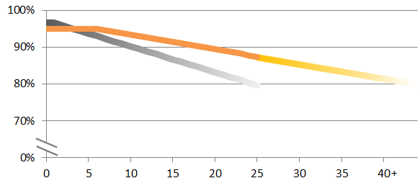
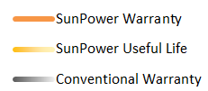
Useful Life Beyond 25 Years
SunPower panels are designed for at least 40 years of service
Useful Life is defined as 99% of the panels producing at least 70% of their rated power.
SunPower’s robust design and industry leading research on accelerated ageing shows SunPower panels are expected to last well beyond their warranty period – at least 40 years.
This is the same in other industries: home electronics and automobiles have a useful life well in excess of their warranty
Much more energy for same upfront cost, higher potential resale value.
1 SunPower Module 40-year Useful Life. SunPower whitepaper. 2013.
Notes:
In many industries, the useful life of the product exceeds the warranty period. For example, a television typically comes with a one year warranty but lasts for many years.
This is not different for SunPower panels. At the end of the 25 year warranty, SunPower panels are guaranteed to be producing more than 87% of their original power, but what happens in year 26? Based on extensive research, SunPower expects 99% of its panels will continue producing at least 70% power for at least 40 years.
As for Conventional Panels, there are clear reliability differences and the future is unclear. We have not seen Conventional Panel manufacturers invest in the level of research and development required to understand the physics of degradation, so many questions remain about the expected degradation and lifetime of Conventional Panels. Based on stress testing, however, it is clear the useful life of a Conventional Panel is much shorter than it is for a SunPower panel.

Slide 24
Energy Production

Slide 25
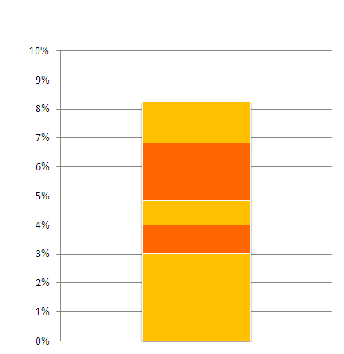
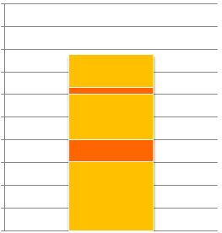
Summary of E-Series Energy Comparisons
Year-One Energy Production
Same Rated Watts
Maintains High Power at High Temps
Higher Average Watts
ENERGY PRODUCTION PER WATT
No Light-Induced Degradation
Better Low-Light and Spectral Response
High-Performance Anti-Reflective Glass
See Slides 56 and 57 for footnotes.
Notes:
We’ll start with a few summary charts which are the primary take-aways for energy production, reliability and efficiency. They show the primary energy-generation benefits of a SunPower system compared with a Conventional system.
This bar chart shows 8% more energy per rated Watt in year 1, from 5 major performance improvements, which we’ll discuss shortly.

Slide 26
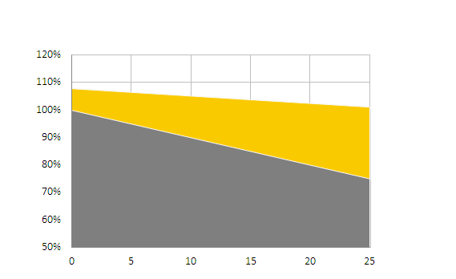
Summary of E-Series Energy Comparisons
25-Year Energy Production
Year-One Energy Production
Same Rated Watts
20%
Same Rated Watts
8% more Year 1
MORE ENERGY
SUNPOWER
ENERGY PRODUCTION PER WATT
35% more Year 25
Maintains High Power at High Temps
Higher Average Watts
CONVENTIONAL
ENERGY PRODUCTION PER WATT
No Light-Induced Degradation
Better Low-Light and Spectral Response
YEARS
High-Performance Anti-Reflective Glass
See Slides 56 and 57 for footnotes.
Notes:
Taking that 8% energy improvement per rated watt, and adding in the degradation rate improvement from the higher reliability, we see that additional energy production advantage grows over the first 25 years of operation, resulting in an average increase of 20% more energy per rated watt for a SunPower system.

Slide 27
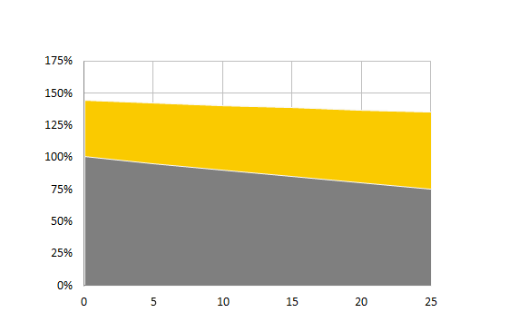
Summary of E-Series Energy Comparisons
25-Year Energy Production
Year-One Energy Production
Same Rated Watts
20%
Same Rated Watts
8% more Year 1
MORE ENERGY
SUNPOWER
ENERGY PRODUCTION PER WATT
35% more Year 25
Maintains High Power at High Temps
Higher Average Watts
CONVENTIONAL
ENERGY PRODUCTION PER WATT
No Light-Induced Degradation
Better Low-Light and Spectral Response
YEARS
Same Physical Size
60%
High-Performance Anti-Reflective Glass
MORE ENERGY
45% more Year 1
SUNPOWER
80% more Year 25
ENERGY PRODUCTION PER ROOF
CONVENTIONAL
YEARS
See Slides 56 and 57 for footnotes.
Notes:
The chart in the lower right adds the SunPower panel efficiency to the energy production advantage to compare two systems which are the same physical size (different rated watts, of course). This shows the other main message: 60% more energy over the first 25 years.

Slide 28
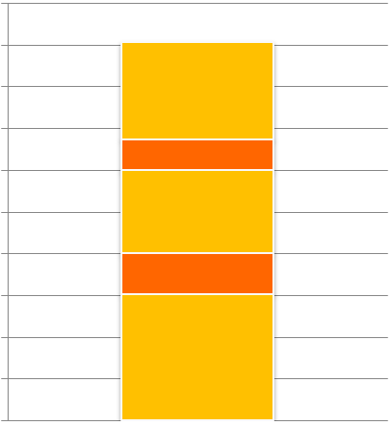
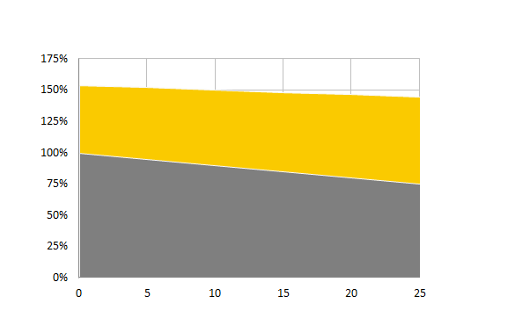
Summary of X-Series Energy Comparisons
25-Year Energy Production
Year-One Energy Production
Same Rated Watts
21%
Same Rated Watts
9% more Year 1
MORE ENERGY
SUNPOWER
Maintains High Power at High Temps
ENERGY PRODUCTION PER WATT
36% more Year 25
Higher Average Watts
CONVENTIONAL
ENERGY PRODUCTION PER WATT
No Light-Induced Degradation
Better Low-Light and Spectral Response
YEARS
Same Physical Size
70%
High-Performance Anti-Reflective Glass
MORE ENERGY
55% more Year 1
SUNPOWER
90% more Year 25
ENERGY PRODUCTION PER ROOF
CONVENTIONAL
YEARS
See Slides 56 and 57 for footnotes.
Notes:
These are the same exact charts, only for the X-Series.
SunPower start with 9% more energy per rated watt, typically, and over the 25 year period that grows to 36% more energy, so the average increase in energy is 21% for a system of the same rated watts.
The tremendous efficiency advantage of the SunPower X-Series Panels (21.5% for E-Series vs. 15.3% for Conventional Panels), creates a huge increase in the year 1 energy: 55% more. That grows over the 25 year period because of SunPower’s high reliability, to almost 100% more energy – so the average throughout this first 25 year period is a whopping 70% more energy from a SunPower system compared with a Conventional system of the same physical size. This choice is certainly clear for any customer who needs the most energy from a small space.
The next slides will build up each part of this energy advantage with the data and independent-party proof so you can feel comfortable knowing how much additional energy you’ll get from a SunPower system. We’ll start first with the additional energy per rated watt in year 1.

Slide 29
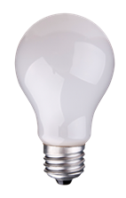
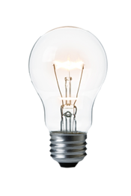
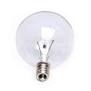
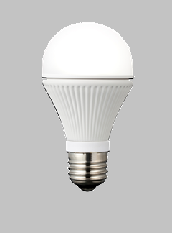
Are All Rated Watts the Same?
All panels are rated on Watts output at 25°C (77°F), 1000 W/m2 of sun (noon on a clear summer day)
But people don’t care about Watts, because the electric company charges for energy … kilowatt-hours (kWh)
Example: Light Bulbs
If we’re comparing only incandescent bulbs, then we know they perform about the same, so we can go by Watts rather than how much light comes out.
But what happens when there’s a different technology?
Rating:
60W
60W
60W
Rating:
7W
x
But people don’t care about Watts, they care about how much light comes out!
But the same amount of light!
… you can’t just use Watts anymore.
Notes:
When having the discussion about how SunPower panels will generate more energy per rated watt, it is key that the customer understands that the SunPower panels are fundamentally different, since competitors are making a variety of similar-sounding claims.
If they understand that the panels are fundamentally different, the following analogy can help explain why the Watt rating is not directly related to the Energy output:
When you were buying light bulbs 20 years ago the only type of light bulb to choose from was an incandescent bulb. You probably had a pretty clear notion about how many 60W bulbs you might need to light up a particular room, because you know about how much light comes out of a 60W incandescent bulb. You are using the “Watts” to choose your light bulbs, and that works fine when the bulbs are all about the same … but what you really care about is how much light you’ll get for your room.
What happens, however, when a different technology comes along, like an LED light bulb? Now that new 7 watts bulb gives you the same amount of light as a 60W bulb, and so you can no longer use “Watts” to infer how much light you’re going to get. Now you actually need to look at the amount of light generated.
Similarly, if all solar panels are the same as the Conventional Panels, then it works pretty well to use their “rated watts” or “nameplate watts” to figure out how much energy you’ll get per year. The problem comes when there’s a different technology – like SunPower panels – which have a different energy output for the same rated watts. It’s like the LED light bulb which generates more light output for the same rated watts.
After all, the energy generated is what the electricity bill is about, kilowatt-hours, and that’s the value that a solar installation is delivering.

Slide 30
Are All Rated Watts the Same? No.
All panels are rated on Watts output at 25°C (77°F), 1000 W/m2 of sun (noon on a clear summer day)
Many days, and morning & afternoon of each day, do not have this much sun light.
Many sunny days are hotter, especially on the roof. High temperatures decrease power.
SunPower’s Maxeon cells deliver more energy (kWh) per Rated Watt because of the unique design, especially in hot or low-light conditions.
Notes:
A big part of what’s problematic about the watt rating of panels is that they are rated under rather cool operating conditions, 77F, with a lot of sunlight … the equivalent of a high-noon sun on a clear and very cold day coming straight down onto the panels.
But if you want to figure out the energy production from a solar panel, you need to know how it performs under ALL the conditions that happen throughout the year: generally hotter operating temperatures since they are on the roof in the sun, and often the sun is not directly over-head – like every morning and afternoon, and throughout the winter.
It’s the improved energy generation at all these non-optimal hours of the year which enables SunPower systems to deliver more energy than systems made with Conventional Panels, even if they have exactly the same watt rating (which of course means that the Conventional system is considerably larger in size).

Slide 31
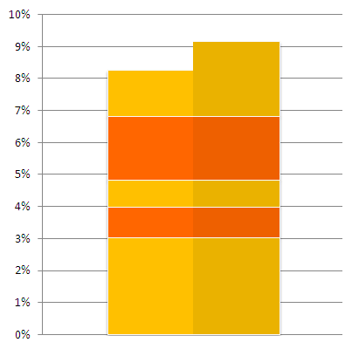
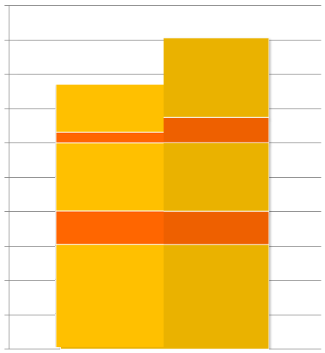
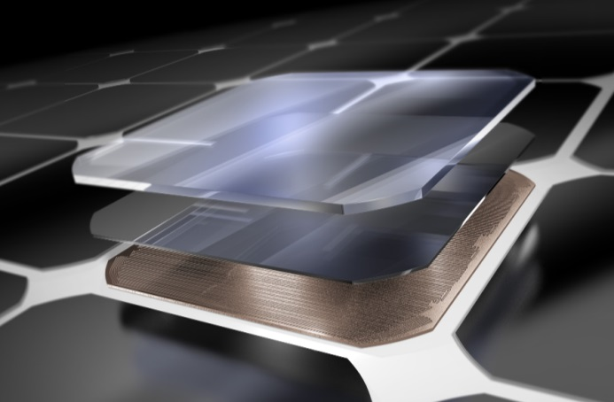
Maxeon Cell Design Delivers More Energy Per Rated Watt
Typical Energy per Rated Watt Increase
Compared with Conventional Panels
X-Series
E-Series
Maintains High Power at High Temps
Higher Average Watts
No Light-Induced Degradation
Better Low-Light and Spectral Response
Maxeon Cell Technology
High-Performance Anti-Reflective Glass
SunPower E-Series Panels deliver 7-9%¹, and X-Series 8-10%², more energy per rated watt.
1 BEW/DNV Engineering "SunPower Yield Report,“ Jan 2013. Compared to Conventional Panels.
2 Like E-Series but with a lower temperature coefficient. CFV Solar Test Lab Report #12063, Jan 2013.
Notes:
This chart shows the typical additional energy generated per rated watt for a SunPower panel vs. a Conventional Panel. 7-9% more for E-Series, and 8-10% more for X-Series.
All the numbers in this section are from an independent assessment by BEW Engineering, an Independent Engineering company that’s part of DNV KEMA Energy & Sustainability, Inc, wholly owned subsidiary of DNV. They studied the E-Series energy production and conclude: “Depending on the climate, the type of fixed or tracking structure that has been deployed, and the exact properties of the competitor’s module, the yield edge can reasonably be expected to range from 7% to 9%” for SunPower E-Series Panels
This chart shows a typical result, with an E-Series panel delivering 8% more energy compared with a Conventional Panel, and the X-Series a percent higher because of even better performance at higher temperatures. There are five primary factors for this increased energy per rated watt, and the following slides give the underlying science behind each one:
Maintains high power at high temperatures
No Light-Induced Degradation
Higher Average Watts
Better low-light and spectral response
High-performance Anti-Reflective glass
We’ll go through each of these five areas and summarize the reasons for the extra energy.

Slide 32
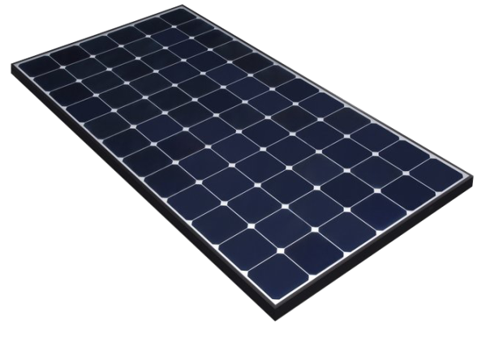
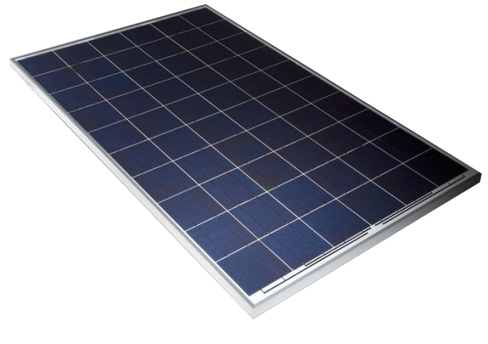
SunPower Panels Stay Cooler
Because of the additional efficiency, more of the sun’s energy is converted to electricity
So less energy needs to be transferred to the air as heat and the panel stays cooler: typically 2-3°C (4-6°F) cooler on the roof
SunPower
Conventional
Sun 1600W (mid-day in summer)
Sun 1600W
1600W x 20.4% = 330W electricity
1600W x 15.3% = 250W electricity
Heat
Heat
1600W
- 330W
1270W Heat
1600W
- 250W
1350W Heat
Conventional Panels run hotter because less of the sun’s energy is converted to electricity.
Notes:
Factor 1: Maintains high power at high temperatures
This comes in two parts: first, the panels stay cooler than Conventional Panels, and second, they maintain their efficiency better at high temperatures.
The fact that SunPower panels stay cooler comes from one of nature’s most fundamental laws: the conservation of energy. If the same amount of energy is coming into the panel from the sun, and more energy is coming out of the panel as electricity (because of it’s higher efficiency), then there’s less energy left that needs to be dissipated out of the panel as heat.
The pictures illustrate this, with the SunPower panel and the Conventional Panel both getting 1600 watts of light from the sun (typical mid-day sun for a nice bright sunny day). The SunPower panel on the left is generating 330W of electricity because of its high efficiency, and the Conventional Panel on the right is only generating 250W of electricity … so the Conventional Panel has 80W of energy that comes out as heat rather than electricity, and that heat needs to be transferred to the air.
To transfer more heat into the air, the Conventional Panel needs to be hotter, and that means it will run less efficiently and generate less electricity, because all solar panels get less efficient as they get hotter.

Slide 33
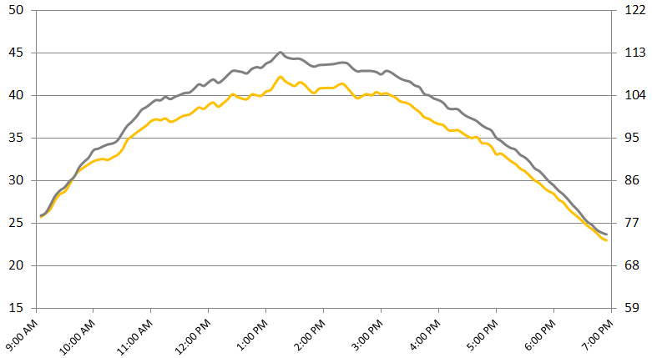
Operating Temperatures: SunPower vs. Conventional Panels
High efficiency panels operate at lower temperatures because they convert more of the sun’s energy to electricity¹
SunPower vs. Conventional Panel temperatures
California roof: 5-7 m/s (11-16mph) wind speed, 950 W/m² irradiance, 28°C (82°F) air temperature
Temperature (ºC)
Temperature difference:
2–3°C (4-6°F) cooler in the sun
Temperature (ºF)
1 Module temperature measurements, SunPower white paper. June 2013.
Notes:
Factor 1: Maintains high power at high temperatures (continued)
This data shows the cooler operation of the SunPower panels vs. Conventional Panels when they are both mounted on a sloped roof in exactly the same way. Through the middle of the day the SunPower panels are 2-3°C (4-6°F) cooler, since they are generating more electricity and therefore less heat.
[Very sophisticated customers might be aware of NOCT – the Normal Operating Cell Temperature – which is supposed to represent a typical panel temperature on a 25°C (77°F) day under moderate sun and low wind, and they might note that SunPower datasheets indicate 45°C (113°F). But a good number of Conventional Panels also note 45°C (113°F), which suggests there’s no temperature advantage. Unfortunately, any 15.3% efficient panel that’s claiming an NOCT different from 47°C (117°F) is just gaming their data sheet (usually by submitting lots of samples to several different test labs and choosing the lowest NOCT panel result). SunPower doesn’t play those games. Whatever the competition states, you can be sure SunPower is 2-3°C (4-6°F) below in NOCT vs any panel that is 15% efficient – that’s just nature’s law of the conservation of energy.]

Slide 34
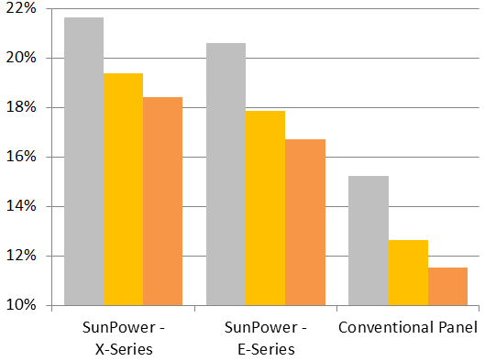
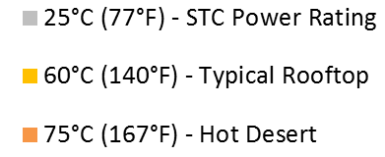
Higher Energy Production in Real Conditions
As the temperature increases, all solar technologies perform at lower efficiencies.
SunPower panels change more slowly than Conventional Panels so they maintain their efficiency advantage even in hot environments.¹
Panel Temperature
Panel Efficiency (%)
SunPower X-Series panels have 50% more power than Conventional Panels at rooftop temperatures. E-Series panels have 40% more power.
SunPower panels maintain the highest efficiencies, even in hot climates
1 Based on temperature coefficients provided in manufacturer datasheets
Notes:
Low operating temperature is important, because all panels perform less efficiently as their temperature increases. The rate at which the efficiency changes is known as “temperature coefficient”, and some solar technologies have better temperature coefficients than others. This means that, despite two panels having a similar nameplate power rating, which is measured at room temperature, their performance in real world conditions can differ significantly.
SunPower has among the lowest temperature coefficients in the industry, maintaining SunPower’s efficiency advantage even in the hottest conditions.
For example, on a typical residential rooftop, panel temperature is around 60°C (140°F). In these conditions, E-Series is 40% more efficient than Conventional Panels and X-Series is 50% more efficient. This advantage continues even into hot desert environments, where panel temperatures can reach 75°C (167°F). In hot desert conditions, E-Series is 45% more efficient than Conventional Panels and X-Series is 60% more efficient.
[Savvy customer might ask: does this data account for the lower operating temperature of SunPower panels from higher efficiency? Answer: No –accounting for our lower operating temperatures would increase our advantage further.]
[Savvy customer might ask: what about CdTe? Doesn’t this have better performance in hot conditions? Answer: CdTe has a similarly low temperature coefficient as SunPower; however, their efficiency is substantially lower. In hot desert conditions, SunPower E-Series is 45% more efficient than Conventional Panels and X-Series is 60% more efficient. This higher efficiency means more energy density and the advantages that come with it – such as fewer panels to maintain, lower BOS requirements.]

Slide 35
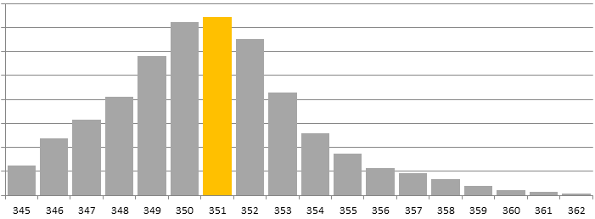
Higher Average Panel Watts
It takes computer-chip-making accuracy to produce high-efficiency solar cells, resulting in panels which are all very similar in power.
SunPower sells almost all its panel production under one model, so typically over-delivers by 6 to 7 watts
Conventional Cell production results in a broad distribution of panel power ratings, which are then binned into 5 watt increments
Production distribution for SPR-X21-345¹
Rated Watts: 345W
(Nameplate)
Average Watts: 351W
Number of panels
Panel Wattage
1 SunPower data from Q4’13 for SPR-X21-345
To improve accuracy, SunPower calibrates is panels through the National Renewable Energy Laboratory using SOMS current and LACSS voltage and fill factor.
Notes:
Factor 2: Higher Average Watts
There’s a big difference between manufacturing 16-18% solar cells to create a 15-16% efficient Conventional Panel, and manufacturing 22.4% efficiency solar cells to create a 20.4% SunPower E-Series panel.
The Conventional Cells are manufactured in a 10-step process that allows for considerable variation in the steps.
In order to get to very high levels of efficiency, however, SunPower requires that every single step of a 20-step process is highly controlled to eliminate any variations. SunPower has the capability to do this because of it’s heritage … it was spun out of Cypress Semiconductor, which makes computer chips. Computer chips have millions of transistors and are made from hundreds of processing steps, and each step needs to go perfectly or the entire chip is worthless. SunPower applies the same manufacturing methodology, called Statistical Process Control, to manufacture it’s very high efficiency solar cells. Frankly that’s the only way to get to these incredibly high levels of efficiency.
As a by-product of this very highly-controlled manufacturing method, the output efficiency of all the solar cells that SunPower produces are extremely similar. In fact, when you make panels from those cells, you get the distribution shown in the chart for X-Series: almost every panel lies within 345 and 362 Watts. That’s less than a 3% spread around the average of 351 Watts, and they are all sold as 345W panels.
By contrast, the Conventional solar cell manufacturing process generates a very wide distribution of output power in the cells, and they need to be binned up into gradations of efficiency, and then put into panels that span a wide range. For example, panels ranging from 230W to 270W, a +/- 8% spread. These panels are then binned into 5 Watt increments and sold as 230W, 235W, 240W, … 270W.

Slide 36
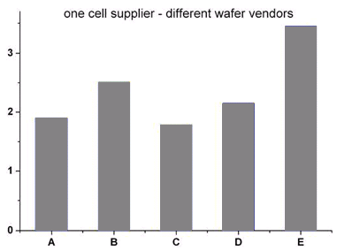
No Light Induced Degradation (LID)
SunPower n-type solar cells are not subject to LID and do not lose 1-3% of their rated power once exposed to sunlight like Conventional c-Si cells (which are p-type silicon).
BEW/DNV Engineering report1: “Actual LID data from manufacturers is rarely available, but generally accepted to be between 0.5% and 3.5% for polysilicon and between 2% and 5% for monosilicon cells.”
Conventional Cells²
Power Loss from LID (%)
SunPower panels do not have Light Induced Degradation.
1 BEW Engineering, part of DNV KEMA, SunPower Yield Report, Jan 2013.
2 Pingel, S., et al., “Initial Degradation of Industrial Silicon Solar Cells in Solar Panels,” EU PVSEC, Valencia 2010.
Notes:
Factor 3: No Light-Induced Degradation
Light Induced Degradation (LID) is a very well documented initial loss of panel efficiency in the first few days of exposure to sunlight. It comes from a chemical reaction that the sun induces in solar cells which are made from “P-type” Silicon ingots. The Conventional Panels have LID because they are made from P-type Silicon which is less expensive.
Conventional Panels of high quality typically have 1-3% LID. Lower quality panels can suffer as much as a 5% reduction in power output from LID, because they are using lower-quality cheaper silicon ingots.
BEW/DNV engineering notes that the LID numbers are hard to get from manufacturers, but the generally accepted numbers by power plant buyers are 0.5% to 3.5% for polysilicon (which are low-efficiency Conventional Panels), and 2-5% for monosilicon (which are the higher efficiency Conventional Panels that we’re comparing against – about 15.3% efficiency or 250 Watts).
SunPower solar cells are made with “N-type” Silicon, which does not have the LID degradation mode at all. (Note that there are some panels with efficiencies that are higher than the Conventional Panels, which are also built with N-type Silicon, like Yingli’s “Panda” panels, LG’s Mono-X Neon panel, and Panasonic panels.)
Note that Conventional solar cell manufacturers can have a significant spread in the amount of LID of their cells, depending on the exact nature of the silicon ingot they are using to create their solar cells. Many Conventional solar cell manufacturers buy silicon ingots from whomever is the cheapest ingot supplier, and do not pay attention to the differences in LID. The chart shows the variability from third-party research data from a bunch of different batches of cells from the same cell manufacturer.
As a general rule, SunPower attributes 2% LID for a good quality Conventional Panel at 15% efficiency.
[Sophisticated customers might want to know the difference between Silicon types that solar cells can be made from. P-type solar cells are made with Boron atoms interspersed in the silicon, and it’s a Boron-related chemical reaction which causes the reduction in efficiency when the solar cell is initially exposed to sunlight. N-type solar cells are made with Phosphorous atoms interspersed in the silicon, and since there’s no Boron, there’s no LID. This is not done by Conventional Cells manufacturers because it fundamentally changes the architecture of the solar cell, and requires different manufacturing steps to make a new type of solar cell. It’s also interesting to note that the purity of the silicon ingot has a big impact on LID, and lower-quality ingots like UMG listed in the table, or Silicon ingots with too much oxygen, will have larger LID.]

Slide 37
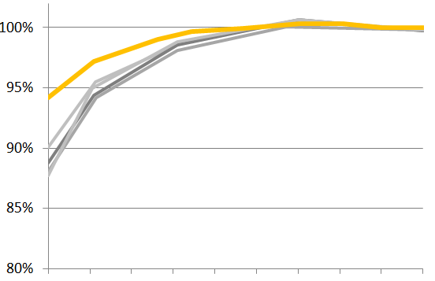
Maintains High Efficiency at Low Light Levels
Photon measurements: Low-light energy production
SunPower Panels Vs. Conventional Panels¹
SunPower Panels
Photon: “The device has a nearly straight efficiency curve with almost no change in the medium-to-high irradiance range and only a minimal drop at low irradiance levels. No other module tested thus far has such an efficiency curve.”¹
Conventional Panels
Efficiency Curve
Maintains high efficiency on cloudy days, and early and late in the day.
100W
Irradiance
1kW
Cloudy
Sunny
1 E-Series and Conventional panels tested by Photon International. June 2012.
Notes:
Factor 4: Better Low-Light and Spectral Response
This plot of data from Photon International shows the output of a solar panel as the light changes from very little sunlight on the left, to full sunlight on the right.
It’s clear that SunPower’s panels continue to hold their efficiency much better at low light levels relative to Conventional Panels, and in fact Photon wrote that SunPower panels “have a nearly straight efficiency curve with almost no change in the medium-to-high irradiance range and only a minimal drop at low irradiance levels. No other module tested thus far has such an efficiency curve” … and it’s worth nothing that they’ve tested 100s and 100s of panels.
[Very sophisticated customers might want to know why SunPower panels do relatively better at low-light conditions. The answer is that they have a very high “shunt resistance.” All solar panels have a “shunt resistance” property which specifies a certain constant amount of energy that a panel generates which will be dissipated as heat internally rather than be output. A high shunt resistance means a small rate of internal energy dissipation, and a low shunt resistance is the opposite. When the panels are operating in full sun, they are generating a lot of energy and that fixed amount that is internally dissipated is a small fraction of the total output. But in low light conditions there is less energy generated, and since the dissipated energy is a constant amount, it becomes a larger fraction of the total energy output, and hence the efficiency declines.]

Slide 38
Broad Spectral Response
Red-shifted sunlight occurs every morning and evening (the sunset colors), so a SunPower system starts earlier and stays on longer.
More light from the blue parts of the spectrum, enables higher energy production in cloudy conditions
More light from the red parts of the spectrum, enables higher energy production in low-light conditions
SunPower Cell ¹
Conventional Cell ²
Sun Spectrum
1 National Renewable Energy Lab measurements "Full, Gen C Bin I1," Mar 2007
2 Green, M. et al., “Solar cell efficiency tables (version 36)” Progress in Photovoltaics, 18(5), 46–352.
Notes:
Factor 4: Better Low-Light and Spectral Response (continued)
This plot shows efficiency of solar panels for each different color light that is coming from the sun. Ultra-Violet light (the kind that causes sun-burns) is on the left side, and infra-red light (the kind that restaurants use to keep the roast warm while it’s being served at the buffet line) is on the right side.
One can see that the SunPower cells can generate electricity from a broader spectrum of sunlight. This is part of why the SunPower cells are higher efficiency and therefore more rated watts, but it also impacts the energy output per rated watt.
Mornings and evenings have proportionately more red light (think about the reds in a sunrise or sunset), so while the SunPower panels are producing electricity efficiently, the Conventional Panels cannot use this light effectively.
That means more energy per rated watt because of the times in the day and year when the solar spectrum is more red: SunPower panels start earlier in the day, and run later into the afternoon.

Slide 39
Anti-Reflective Glass Comparison
Panels with anti-reflective glass have 3-5% energy gain vs. panels with non-AR glass from better light capture when the sun is not directly overhead.
Cloudy periods, Early and Late hours, and the winter season.
The majority of Conventional Panels do not us AR-glass because it is more expensive, and that cost is harder to justify with lower efficiency Conventional Cells.¹
Not all AR-glass is the same… SunPower uses top performing AR-glass.
More light enters when sun is at low angles
SunPower high-performance Anti-Reflective Glass²
Conventional glass³
1 BEW Engineering , part of DNV KEMA, SunPower Yield Report, Jan 2013.
2 Sandia National Lab, Outdoor Performance Characterization of Three SunPower Modules, April 2013
3 Fanney, P., et al. "Comparison of Photovoltaic Module Performance Measurements." Journal of Solar Energy Engineering 128.2, 2006, p 152.
Notes:
Factor 5: High-Performance Anti-Reflective Glass
SunPower uses the best performing AR glass in the industry. That increases the rated watts of each panel, because there’s less reflected light.
But it also increases the energy per rated watt, because there are many situations where the light is not coming straight into the glass, and for those situations, more light gets through the glass and onto the solar cells when AR glass is used.
Try looking out a regular window at a shallow angle and you’ll find that at a certain angle the window becomes entirely reflective, and is acting like a mirror. These sharp angles occur daily for a solar panel (early and late hours of the day), and are worse in the winter or for solar installations where the panels are not tilted up very much to face the sun. When these sharp angles occur and the glass is reflecting the sun, then the light is not entering the solar panel and hitting the solar cells, so there’s no energy generated.
But with AR glass this refection effect can be pushed out to sharper and sharper angels, so the panel can produce energy for more hours of the day. The plot above shows that for a panel where the sunlight is hitting it 75 degrees from perpendicular, non-AR glass panels are reduced by about 30% of the power output, and SunPower’s AR glass panels are reduced by about 10%. The AR glass also helps on cloudy days where the light is coming from every direction, because the solar cells can effectively ‘see’ more of the sky.
Why is the use of AR glass still unusual in Conventional Panels? There are 2 primary reasons:
Most Conventional Panel manufacturers are focused entirely on their $/W cost, and AR Glass is more expensive. They do not measure or focus on the energy advantage (kilowatt-hours) available with AR glass, but only focus on the increase in rated watts, which is often not enough to justify the added cost.
SunPower is in a unique position to capitalize on using an expensive Anti-Reflective glass coating. Because the cells are so efficient, the additional light that hits the cells from a top-performing AR glass results in relatively more energy output (as compared with a Conventional efficiency cell), so there’s a larger economic benefit for AR glass for SunPower relative to Conventional Panels.
One should also be aware that there are many degrees of quality of AR glass coatings, with some top-performers like SunPower’s glass which capture a lot more light at off-angles, and some which do very little. It takes a chart like the one shown here to know whether a panel will get the full potential energy gain from an AR glass coating.
The AR glass off-angle performance accounts for 3.0% of 8.2% SunPower production advantage example shown earlier.

Slide 40
Independent Engineer Assessment
BEW Engineering is part of DNV KEMA Energy & Sustainability, with more than 2,300 experts world wide.
Have provided technical services on over 10GW of commercial and power plant installations
Specialize in modeling expected system energy production
Report reviewed the same 5 primary differentiators for SunPower panels.
BEW/DNV Engineering Conclusion:
“Depending on the climate, the type of fixed or tracking structure that has been deployed, and the exact properties of the competitor’s module, the yield advantage can reasonably be expected to range from 7% to 9%.”¹ (E-Series Panels)
x
1 BEW Engineering, part of DNV KEMA, SunPower Yield Report, Jan 2013. Compared to a Conventional Panel.
All trademarks or logos are the properties of their respective owners.
Notes:
SunPower panels provide additional energy production compared to Conventional Panels due to the five factors just reviewed.
These factors, and the amount of additional energy, came from BEW’s assessment. They are an Independent Engineering firm that’s recognized as one of the best in the world, with a specialty in using models to predict solar power plant energy output.
They used independent lab results from Sandia National Labs which characterize SunPower’s panels in each of these areas, and compared that with Conventional Panels.
BEW’s conclusion: “Depending on the climate, the type of fixed or tracking structure that has been deployed, and the exact properties of the competitor’s module, the yield edge can reasonably be expected to range from 7% to 9%” for E-Series Panels.

Slide 41
Quantifying the $/W Value of More Energy
Depending on the competitor and the mounting and climate conditions:
E-Series: 7-9% more energy per rated watt¹
X-Series: 8-10% more energy per rated watt²
Every 1% of additional energy = 1% of additional system value
In other words, a system that’s twice the cost, and generates twice the energy, delivers the same value on a cost-per-energy basis
Example: an 8% energy increase for a R15/W system3 = R0.32/W value
More Energy per rated Watt in real-world conditions:
Hot roof conditions
Medium and low sun conditions
Off-angle sun conditions
Partially shaded conditions (not included because it does not always apply)
Typical Energy per Rated Watt Increase
Compared with Conventional Panels
X-Series
E-Series
Maintains High Power at High Temps
Higher Average Watts
No Light-Induced Degradation
Better Low-Light and Spectral Response
High-Performance Anti-Reflective Glass
1 BEW/DNV Engineering "SunPower Yield Report," Jan 2013. Compared to Conventional Panels.
2 Like E-Series but with a lower temperature coefficient. CFV Solar Test Lab Report #12063, Jan 2013. Compared to Conventional Panels.
3 Prices are examples for illustration only
Notes:
We’ve now reviewed the 5 factors which lead to the SunPower energy production advantage, as summarized in the bar chart shown here.
The E-Series generates 7-9% more energy per rated watt compared with a Conventional Panel, and the X-Series generates 8-10% more energy per rated watt.
How much is that worth? Well, what’s important is the cost-per-energy-generated, or cost per kilowatt-hour, since that’s what the electric company charges you. So if you pay $4/Watt for a system that gives you 400 kWh/yr of energy, you’d be in the same place if you paid $8/Watt for a system that gives you 800 kWh/yr. Both the cost and the output doubled, so the cost-per-kWh is the same.
So an 8% production advantage is worth 8% of the cost of your system … for example, if you look at a $4/W system, that extra energy is equivalent to $0.32/W of added value (that’s 8% of $4.00).
In other words, as a rule-of-thumb (because other factors can come into play depending on each particular financial situation), you’d be in the same place economically if you paid $4/W for 100 kWh Conventional system, or $4.32/W for 108 kWh (8% more) SunPower system. Importantly, this is ONLY taking account of the additional energy per rated watt of a SunPower panel, and does not include additional energy over time through the better degradation rate.

Slide 42
Photon International Results (kWh/kW)
3rd party test of 102 PV Manufacturers to measure the additional energy per rated Watt
SunPower three E-Series panels ranked #1, #2, and #3, with the most energy per rated Watt out of 151 panels tested¹
SunPower averages 8% more energy per rated Watt compared with the rest of the top 10 panel manufacturers in the study2
X-Series offers an additional 1% more energy-per-watt than E-Series.
In 2013, Photon encountered equipment malfunctions resulting in incomplete measurements
Energy Yield Results (2012)
Energy Yield Results (2013)³
1,200
“Had it not been for our newly-developed testing equipment for IV curves that was still going through its growing pains, this year’s results, as last year, would quite likely have given a gold, silver and bronze sweep for one US company – SunPower Corp…”
1,144
1,140
1,139
8% more energy
1,100
1,056
1000
Production (kWh / kW)
900
800
SunPower 1
SunPower 2
SunPower 3
Average production
of all panels from:
Yingli, Canadian Solar, Trina Solar, Suntech, Jinko Solar, Hanwha SolarOne, Kyocera, Sharp, Talesun
1 Photon International, February 2013 .
2 9 of the top 10 manufacturers were tested, based on Photon Consulting 2013, Silicon module shipments.
3 Photon International, February 2014.
Notes:
Here’s some proof from independent field testing.
For many years, Photon has been running the most comprehensive study of energy production in the solar industry.
SunPower previously has not joined this study, because the design differences in SunPower panels make flash-testing them different from Conventional Panels. Flash-testing is the process by which a light is shone onto the panel, and then the output power is measured to give the panel its rating. SunPower panels are unique in having a copper foundation, and all that metal causes a slower reaction time to the flash test, and labs which do not slow down their flash testing system will not get an accurate rating.
After the 2012 testing, SunPower’s panels had generated the most energy per rated watt and ranked #1 out of the tremendous number of panels being tested. Taking the performance of the top 10 panel providers, the SunPower panels average 8% more energy per rated watt – in line with the prediction (despite this test happening in Germany, where the high-temperature energy output advantage of SunPower panels doesn’t have as much impact as it would in many warmer sunnier regions).
Photon’s 2013 rankings did not include SunPower due to Photon’s insolvency and subsequent technical issues resulting in corrupted data and partial reporting. However, Photon published in their report that, had there been no issue, SunPower would likely have been ranked number 1, 2, and 3 as in 2012. When comparing the two summer months for which there is data, May and June, SunPower continued to show an 8% yield advantage
This is powerful 3rd party validation of the 7-9% energy advantage of the E-Series SunPower panels.

Slide 43
Lower Shading Impact than Conventional Panels
Independent test lab study of the impact of partial shading on SunPower panels vs. Conventional Panels¹
Each string identically shaded with real-world partial-shade conditions: 2 vent pipes along south edge, 1 tree on east side, 4 leaves on the panels
Daily energy output measured, and each string compared with its own un-shaded energy production
SunPower cells have built-in diode protection, so partial-shading has much less impact. Compared to Conventional Panels in these shade conditions:
E-Series has 20% higher yield
X-Series has 30% higher yield
SunPower panels on a string inverter outperform Conventional Panels on micro-inverters
30% more kWh
20% more kWh
% Unshaded Performance¹
SunPower
X-Series, String Inverter
SunPower
E-Series,
String Inverter
Conventional
Panel,
String Inverter
Conventional
Panel,
Micro-Inverter
2 MINUTE VIDEO ABOUT SHADE TESTING
1 PV Evolution Labs "SunPower Shading Study, " Feb 2013. Compared to a Conventional Panel (240W, 15% efficient, approx. 1.6 m2)
Notes:
Here’s another key difference for the SunPower panels – which is actually not counted in the 7-10% energy production advantage example, but can be very important for some installations: the panels have diode protection built into every cell. That means they are much less impacted by the real-world shading that can happen at many sites … for example, the shadow from electrical wires, vent pipes, and growing trees, or even fallen leaves, bird droppings, and uneven build-up of dirt.
If a Conventional Cell is shaded, that cell cannot pass electricity, and that single shaded cell will cause a full third of the panel to be bypassed via the panel’s bypass diode. Over time, this can become a reliability risk because the diodes are really a back-up system and are often not appropriately sized. When the diode burns out, the electrical current will be forced back through the cells, and will cause hot-spots around the shaded cell that will lead quickly to permanent failure of the panel and the loss of the power from the entire string of panels.
In contrast, the Maxeon cells are able to pass electricity through even when they are shaded. That means no reliance on bypass diodes, and it means more energy production in partly shaded conditions. A single shaded cell will reduce the panel output of a Conventional Panel by 33%, but an E-Series panel by only 11% and an X-Series panel by only 6%.
This was demonstrated in a study conducted by PVEvolution Lab, an independent test lab owned by the independent engineering firm, DNV-GL.
They setup both SunPower and Conventional Panels in identically shaded real-world conditions and compared the energy production. Each setup was a string of 8 panels, four of which had a leaf shading a single cell, plus each setup had two vent pipes on the south edge of the panels and a tree on the east side which caused shadows to sweep across parts of the array as the sun crossed the sky. Every day the energy output was measured and compared to un-shaded energy production.
The results are shown in the plot: SunPower’s X-Series panels produced 30% more energy than the Conventional Panels – very low because of improvements in the diode protection we’ve made with these new panels. The E-Series panels yielded 20% more energy. The Conventional system’s performance was reduced by almost 1/3 on the normal string inverters. We also compared against a Conventional system where each panel had its own micro-inverter, and the result was essentially the same: 28% reduction energy … the micro-inverter didn’t make any real difference.
So the E-Series had 20% higher yield compared with the Conventional Panels (with or without micro-inverters), and the X-Series had 30% higher yield than Conventional Panels.
We do not generally recommend setting up panels in partly shaded conditions, since it lowers yield; but, in the real world this happens regardless of how the systems is designed (e.g. fallen leaves, tree growth), and sometimes it even makes sense to do this in the design, given the constraints of maximizing the system size on a roof (e.g. getting close to vents and chimneys). It’s important to know that the SunPower panels will generate far more energy in these conditions compared with Conventional Panels, and can operate without any impact on the reliability and lifetime of the panel.
This additional energy per rated watt due to more production in partially shaded conditions is NOT factored into that 7-9% energy advantage because it depends on the particularities of a site, and some sites have no shading or soiling.
[Some customers might ask: “why didn’t the micro-inverter help … I thought they are designed to handle partly shaded conditions?” Answer: A micro-inverter is doing the same thing as a string inverter to get the maximum power out of a panel – it’s just doing that on a single panel rather than a string of several panels at the same time. So there’s no benefit in energy production for a micro-inverter unless either of the following is true:
You cannot have all the panels in a string aimed in the same direction. If you have small sections of roofs aimed in different directions that you want to use for panels, then you need micro-inverters to get the most out of each individual panel.
If you have two or more strings sharing the same MPP tracker (Max-Power-Point tracker”), and only one of those strings is shaded, then those two strings will have different maximum-power-points, and the shaded string will bring down the power of the unshaded string. This can be overcome by putting the panels on micro-inverters, or by putting the strings on different MPP trackers (for example, inverters are starting to offer two MPP trackers).
Note that a third possible situation for micro-inverter benefits is not related to performance, but rather to installation costs. For very small systems, it may be easier to install micro-inverter-fitted panels rather than a string inverter.]
[Very technically savvy customers might ask “what does ‘diode protection built in’ really mean?” Answer: a Conventional Cell has a reverse break-down voltage of -15 to -17 volts, and the breakdown is defect-driven and very local on the cell and causes high temperatures and permanent damage. The bypass diode of the panel protects the cell from ever getting past about -10V, so this “reverse-biased breakdown” is prevented from happening and this damage doesn’t occur is long as the bypass diode is working. But also there’s no energy production in the third of the panel that’s been bypassed. The SunPower Maxeon cell, however, has a -5.5V reverse-bias break-down voltage for E-Series panels, and -2.5V for X-Series panels, and when they are in a reversed-biased condition (meaning they are being forced to pass through the current from the rest of the cells, even though they are shaded), they breakdown evenly over the entire area of the cell with much lower temperatures and no damage to the cell or the panel.]

Slide 44
SunPower Panels are More Reliable in Shade
Conventional Cells require diodes for protection:
Damaging hot spots form when a Conventional cell is shaded¹, so diodes are needed to bypass a shaded cell.
Heat ages diodes, frequent shading ages them faster, and failed diodes do not protect the cells.
SunPower Cells have diode protection built into each cell:
Unique cell characteristics mean 90% less heat is generated, and the heat is emitted uniformly across the cell, so the temperature stays low.²
Since cells run reliably under shade, SunPower uses diodes only to optimize energy yield.
Shaded Cell Temperature over Time²
>150°C (300°F) in 2 minutes
Reliability Risk Zone
1 Breitenstein, et. al. Understanding junction breakdown in multicrystalline solar cells. Journal of Applied Physics, 109(7), 071101.
2 Campeau, Z. et al. "SunPower Module Degradation Rate," SunPower white paper, Feb 2013
Notes:
When solar cells are shaded from trees or soiling, they develop a counter voltage to match the current from the neighboring cells, causing the shaded cell to heat up. The total amount of heat and size of the area which dissipates the heat depends on the cell design.
Conventional Cells develop localized hot spots when shaded, which can reach temperatures high enough to destroy the cell¹. As a result, these panels depend on diodes in the junction box to bypass a shaded cell, resulting in 33% power loss – even when just one cell is shaded². Frequent shading ages diodes faster, and failed diodes do not protect the cells from hot spots under shade.
SunPower cells have a unique architecture which manages shading differently than Conventional Cells. When shaded, they generate 90% less heat, uniformly across the cell, so the temperature stays lower. Since cells run reliably under shade, SunPower uses diodes to optimize energy yield. In SunPower panels, a diode only activates once several cells are shaded and the waste heat from shaded cells outweighs the energy harvest from the unshaded cells.

Slide 45
Accurately Predicting the SunPower Energy Advantage: PVSim
PVSim is a state-of-the-art Energy Model
“PVSim is an accurate simulator for SunPower and non-SunPower PV systems. For SunPower systems, it offers a simple approach with little user adjustment necessary. For non-SunPower systems, it allows for extensive customization of a broad range of input parameters as needed.”1
“Uses the Sandia National Labs Photovoltaic Performance Model with module coefficients established through 3rd party Sandia testing.”¹
Eliminates gaming of the modeling programs by manufacturers through self-reported and unvalidated datasheets.
Audited by BEW/DNV Engineering, an independent engineering firm:
“BEW using PVSim obtained results closer to measurements than BEW using PVSyst with comparable modeling assumptions.”
“Compared to measured data, PVWATTS is 10-30% low in annual energy, and modeled-to-measured power correlations are poor.”
“PVSim generally uses state-of-the-art algorithms that should yield accurate results.”
Use PVSim online for free: https://pvsim.sunpowercorp.com/PVSim/Login.aspx
Nothing is more important than getting the energy production right, since what we are really selling is the promise of future energy!
1 BEW Eng, part of DNV KEMA, PVSim Evaluation Report, Jan 2013.
Notes:
SunPower’s challenge is to have our partners use energy production models which accurately calculate energy output. Often modeling tools such as PVSyst and PVWatts do not account for the 5 factors previously discussed. This is especially true with PVWatts where a manufacturer’s brand can not even be identified so there’s no possibility to demonstrate the SunPower energy production advantage. That leads us to our next topic …
What people are actually buying when they by a solar system is the promise of future energy production: nothing is more important than getting that estimate of future energy production as accurate as possible.
So it’s critical to use an accurate tool, and PVSim is the best tool available. And it’s free and already available to you.
The accuracy of this energy prediction software was evaluated by BEW, a very sophisticated Independent Engineering firm which specializes in doing accurate energy production estimates for massive Solar Power Plants. They reported that
“PVSim is an accurate simulator for SunPower and non-SunPower PV systems. For SunPower systems, it offers a simple approach with little user adjustment necessary. For non-SunPower systems, it allows for extensive customization of a broad range of input parameters as needed. It incorporates advances algorithms and defaults based on data from a large fleet of installed systems to provide accurate results without the need for extensive knowledge of PV physics by the user”
PVSim is more robust and unbiased than the other tools because it uses the Sandia National Labs Performance Model with module coefficients established through 3rd party Sandia testing … that eliminates gaming of the modeling programs by manufacturers through self-reported and unvalidated datasheets.
BEW Engineering also reported that:
“BEW using PVSim obtained results closer to measurements than BEW using PVSyst with comparable modeling assumptions.”
“Compared to measured data, PVWATTS is 10-30% low in annual energy, and modeled-to-measured power correlations are poor.” Please do not use PVWatts for anything. (In fact, even NREL, the makers of PVWatts, do not recommend it for predicting system energy for real systems – it’s supposed to only give a rough idea of energy production for solar education purposes.)
“PVSim generally uses state-of-the-art algorithms that should yield accurate results.”
Best of all, you can use this state-of-the-art tool for free, anytime you want, on the web!

Slide 46
Efficiency

Slide 47
The Maxeon Solar Cell is the Core of the SunPower Technology
Maxeon cells are back-contact silicon cells built on a solid copper foundation
Up to 24.2% efficient cells in commercial production
SunPower Maxeon Cell Efficiency Advantage¹
24%
22%
20%
18%
SunPower holds the world-record large Silicon panel efficiency (22.4%). Green, M. A., et. al. “Solar Cell Efficiency Tables” Progress in Photovoltaics, 2014
Cell Efficiency (%)
16%
14%
12%
10%
Thin Films
Standard
Silicon
HIT
SunPower
Maxeon
Gen 2
SunPower
Maxeon
Gen 3
SunPower continues to out-innovate the competition
1 Cell efficiencies based on high volume production
Notes:
SunPower’s Maxeon cell is what drives our efficiency – the highest in the world by far for any commercially available solar panel. Period.
Don’t be fooled by claims around particular sub-classifications of technologies: like “18% = world-record poly-Si cell efficiency,” or “18% = highest efficiency cell that uses screen-printing,” or “highest HIT-cell efficiency.” These claims are all reducing the comparison points to a smaller set of technologies.
Bottom line: SunPower holds the world record for most efficient panels, at 22.4%, and SunPower sells the highest efficiency panels you can buy and put on your roof – and that means the most energy you can get from your roof. Full stop.
The chart shows the various different technologies, and where they are at the cell-efficiency level (not the panel efficiencies, which are lower). SunPower continues to out-innovate the competition, and has even widened the gap with the Maxeon Gen 3 cell – which makes up the X-Series panels.

Slide 48
SunPower Continually Reinvests in R&D
SunPower leads research and development, demonstrated by a track record of innovation and patents.
Number of Patents Issued per Year¹
Number of patents
SunPower: #1 solar company for assigned patents
1 Heslin Rothenberg Farley & Mesiti P.C. (2014). Clean Energy Patent Growth Index: 2013 Year in Review. Non-solar companies (Canon, Boeing) removed for clarity.
Notes:
SunPower has led the industry in developing more reliable, more efficient, and more powerful solar for decades. These gains are the result of significant and continuous investment in bleeding edge research and development, and SunPower’s technical leadership is demonstrated through number of issued patents, where SunPower is the industry leader.

Slide 49
Overview: X21 Solar Panel
Best PV Panel on Every Dimension: Energy Production¹, Reliability², Efficiency³ and Aesthetics
335 Watts
21.2% average efficiency
345 Watts
21.5% average efficiency
World’s highest energy and power solar panel
Delivers the maximum power possible from your roof¹
More energy output in hot locations and summer months when sunlight is strongest²
Unique Signature™ Black look
Delivers the most energy even when located in small shadows like vent pipes, pole or wire shadows, or when partly covered with fallen leaves or dirt²
Holds world record 22.4% panel efficiency!³
1 Compared with E-Series solar panels..
2 See Slide 57 for footnotes
3 Green, M. A., et. al. “Solar Cell Efficiency Tables” Progress in Photovoltaics, 2014
Notes:
SunPower’s X-Series panels are the best panel on the market in every dimension: Energy, Reliability, Efficiency and Aesthetics.
The most power from your roof from the highest efficiency: 41% more energy compared with the same sized Conventional array that made of the standard 15.3% efficiency panels.
More energy production per rated watt: enhanced beyond the 7-9% advantage (over Conventional Panels) that the E-Series has, with an even better temperature coefficient, for an 8-10% energy production advantage in year 1.
Combining that with the same unmatched reliability of the E-Series – it’s built on the same copper foundation – means an average of 21% more energy per rated watt each year over the first 25 years.
It also offers an unparalleled aesthetic. Like the E-Series panels, they have a clean elegant look with no metal lines on the front of each cell. The X-Series further improves this look with an even blacker cell – allowing the Signature Black X-Series panel. Mounted on a roof, they look like a sleek flat-panel high-definition TVs! This is the only choice for customers who are concerned that Conventional solar detracts from the appearance of their home.
Finally, for situations where the solar installation is sometimes in partial shade, the X-Series is unparalleled in maintaining its energy production.
This is the best panel on the planet – hands down!

Slide 50
The Value of High Efficiency
More power from the same space: the SunPower system will deliver 60% more energy in the first year. After 25 years, the difference will grow to almost 100% more energy … for an average of 70% more energy each year.1
Most roofs are constrained by south-facing size, and shadows (trees, vents, wires, etc.)
More expandable later if energy needs increase in the future (e.g. electric car)
More Power from a Limited Roof Space
Conventional Panel
6.2kW System
SunPower
6.2kW System
Won’t fit on available roof space
Same Energy production over 25 years
Less Shading with SunPower
SunPower Panels
Conventional Panels
1 Based on 345W SP panels, 250W Conventional Panels. See footnote on slide 57.
Notes:
To the customer, the primary benefit of high efficiency is getting more energy from their available roof. “Available roof” is generally much smaller than the entire roof, since only south-facing and relatively unshaded areas of the roof can be used for solar installations. The house on the right shows how the tree shading can be avoided with the smaller-sized SunPower installation, and still attain the same rated watts.
If the customer deploys the same sized solar system – the same number of panels – then the SunPower array will generate 70% more energy over the first 25 years of operation compared with the Conventional system.
The picture on the left shows a schematic of a house with two 6.2kW rated systems where the Conventional system just doesn’t fit. It takes 25 250W Conventional Panels to get to the same rating as 18 345W SunPower panels … and the SunPower system at the same rating will generate an average of 21% more energy each year over the first 25 years, which means only 15 panels are necessary to generate the same energy as the 25 panel Conventional system.
If you’re comparing SunPower X-Series against Conventional 250W panels – and you can only install the same number of each panel – then the SunPower system will deliver 60% more energy in the first year (from the higher efficiency and more energy per rated watt). After 25 years, the difference will grow to almost 100% more energy (from the lower degradation rate with time) … for an average of 70% more energy each year.
For customers with enough available roof to meet their current energy demands, this additional energy generation provides flexibility for the future. With extra available roof space still unused, the SunPower system can easily be expanded, for example, if the customer buys an electric car in the future – which would very significantly increase their electricity usage.

Slide 51
Sustainability

Slide 52
SunPower Environmental Advantage
Clean from start to finish… to start
In 2014, SunPower panels became the 1st Cradle to Cradle Certified™ Silver (C2C) solar product and technical product, demonstrating SunPower’s leadership in environmental stewardship and sustainable product design.
Cradle to Cradle Certified™ is recognized by the US Green Building Council’s LEED v4 Standard and can provide additional points towards LEED certification.
SunPower panels directly contribute up to five points in the “Energy and Environment” and “Materials and Resources” categories¹.
There are additional credits, which represent 38 points, to which the company’s products may also contribute; depending on project scope and which credit categories are pursued.
SunPower panels can provide over 30% of the points required for LEED certification
1 McNaughton Consulting. (2014). LEED Information Sheet. Cradle to Cradle Certified™ is a certification mark licensed by the Cradle to Cradle Products Innovation Institute.
Notes:
In addition to economic benefits, many customers are interested in going solar because of the environmental and social benefits of clean energy. However, the value chain for solar products remains opaque as the industry matures, and it is difficult to understand the total environmental and social impact of the sourcing, production, installation, and disposal of solar panels. SunPower demonstrates its leadership in having a transparent and responsible product life cycle from start to finish through the Cradle to Cradle Certified Product Standard.
This stringent standard evaluates products and their manufacturers based on achievement in 5 categories:
Material Health - Products ingredients are inventoried throughout the supply chain and evaluated for impacts to human and ecological health
Material Reutilization - Products are designed to either biodegrade safely as a biological nutrient or to be recycled into new products as a technical nutrient
Renewable Energy and Carbon Management - The criteria at each level build toward the expectation of carbon neutrality and powering all operations with 100 percent renewable energy
Water Stewardship - Processes are designed to regard water as a precious resource for all living things and at each level progress is made toward the expectation of all effluent being clean enough to drink
Social Fairness - Company operations are designed to celebrate all people and natural systems and progress is made toward having a wholly beneficial impact on the planet
C2C certification is more than just a title, in fact, it qualifies for X additional points under the LEED program for buildings. When combined with other points, SunPower panels can contribute up to Y points, or over Z% of those required for a building to receive LEED certificaiton.

Slide 53
Faster energy payback time
Brookhaven National Laboratory and Columbia University Study
Lifecycle assessment considers environmental impacts from the entire product lifecycle: from raw material extraction to production, installation, and eventual decommissioning.
One measure in lifecycle assessment is Energy Payback Time (EPBT), the number of years required for a panel to offset its lifecycle.
Brookhaven National Laboratory and Columbia University’s Center for Life Cycle Analysis studied the role of panel efficiency on EPBT.
SunPower panels have a 1.4 year EPBT – all of the energy produced after this time is a net gain. This is 20% faster than Conventional Panels.1
SunPower panels require just 1.4 years to pay back the energy needed to build and deploy them
1 Fthenakis, V. M. et al. (2012). Life Cycle Analysis of High-Performance Monocrystalline Silicon Photovoltaic Systems: Energy Payback Times and Net Energy Production Value. 27th EUPVSEC.
All trademarks or logos are the properties of their respective owners.
Notes:
The Energy Payback Time is another way to measure environmental impact. It’s the amount of time that the solar panel takes before it’s generated all the energy that it took to make that same panel. Only after that amount of energy is “paid back” is the solar panel contributing to a reduction in green-house gasses.
The Energy Payback for the high efficiency SunPower panels is uniquely short – 1.4 years – since virtually the same materials are being used, but the panels are much higher power.

Slide 54
SunPower End of Life Environmental Advantage
Some solar panels have elements which are considered hazardous:
Silver in front contact paste
Lead found in solder
Cadmium found in thin film
SunPower panels have undergone independent third party toxicity testing for heavy metals and show no significant levels of these toxic compounds.
As a result, removal, reuse, or recycling of SunPower panels does not require hazardous waste handling procedures per US federal and California regulations.
SunPower panels also comply to RoHS guidelines used in the EU.
Cost of End of Life Options¹
$/W of disposal option
More end of life options, lower decommissioning costs, lower risk of future legislation
1 SunPower Corporation. (2014). SunPower Panel Environmental Advantages.
Notes:
SunPower panels have undergone independent third party toxicity testing and show no significant levels of heavy metals usually associated with solar panels. As a result, removal, reuse, or recycling of SunPower panels does not require hazardous waste handling procedures. This provides more flexibility to system owners by lowering costs associated with hazardous waste disposal at decommissioning, reducing risk from future regulations, and increasing panel resale value. This flexibility ultimately lowers risks associated with system sales and increases project profitability. When combined with SunPower’s fast energy payback time, long product life, and clean footprint, system owners have peace of mind that their solar panels are clean from start to finish.

Slide 55
Summarizing the Value

Slide 56
Summary of E-Series Energy Comparisons
25-Year Energy Production
Year-One Energy Production
Same Rated Watts
20%
Same Rated Watts
8% more Year 1
MORE ENERGY
SUNPOWER
ENERGY PRODUCTION PER WATT
35% more Year 25
Maintains High Power at High Temps
Higher Average Watts
CONVENTIONAL
ENERGY PRODUCTION PER WATT
No Light-Induced Degradation
Better Low-Light and Spectral Response
YEARS
Same Physical Size
60%
High-Performance Anti-Reflective Glass
MORE ENERGY
45% more Year 1
SUNPOWER
80% more Year 25
¹ Typically 7-9% more energy per rated Watt compared to a Conventional Panel (250W, 15.3% efficient, approx. 1.6 m²). BEW/DNV Engineering "SunPower Yield Report," Jan 2013. See also Photon International, Nov 2012.
² SunPower 327W compared to a Conventional Panel (250W, 15.3% efficient, approx. 1.6 m2), 8% more energy per watt, 0.75%/yr slower degradation. BEW/DNV Eng. "SunPower Yield Report," Jan 2013. Jordan, Dirk “SunPower Test Report,” NREL, Oct 2012. Campeau, Z. et al. "SunPower Module Degradation Rate," SunPower white paper, Feb 2013. See www.sunpowercorp.com/facts for details
³ 327W SunPower vs. 250W Conventional Panel.
ENERGY PRODUCTION PER ROOF
CONVENTIONAL
YEARS
Notes:
Here are the charts we started with, and if you take away one thing from this, it should be these numbers!
The bar chart on the left summarizes the 5 factors which lead to the SunPower E-Series energy production advantage in year 1 of 7-9% more energy per rated watt compared with a Conventional Panel.
That initial 8% (to use a typical number) is where the orange SunPower bar in the upper right chart starts out in year 1. Then over the 25 years you can see that increase in energy increasing because of the slower rate of degradation of the SunPower panels (0.25% vs. 1.0%). In fact, in year 25, if the Conventional Panels are still functioning, you’ll have 35% more energy from the SunPower system compared with the Conventional system. If you look at this entire first 25 year period, starting at 8% more and ending with 35% more, then you have an average of 20% more energy per rated watt.
How much is that worth? Well, what’s important is the cost-per-energy-generated, or cost per kilowatt-hour, since that’s what the electric company charges you. So if you pay $4/Watt for a system that gives you 400 kWh/yr of energy, you’d be in the same place if you paid $8/Watt for a system that gives you 800 kWh/yr. Both the cost and the output doubled, so the cost-per-kWh is the same.
So a 20% production advantage is worth about 20% of the cost of your system … for example, if you look at a $4/W system, that extra energy is equivalent to $0.80/W of added value.
In other words, as a rule-of-thumb (because other factors can come into play depending on each particular financial situation), you’d be in the same place economically if you paid $4/W for 100 kWh Conventional system, or $4.80/W for 120 kWh (20% more) SunPower system.
The situation becomes even more dramatic when comparing two systems of the same physical size, as the chart in the lower right shows. The much higher efficiency of the SunPower panels (20.4% for E-Series vs. 15.3% for Conventional Panels), creates a huge increase in the year 1 energy: 50% more. That grows over the 25 year period because of SunPower’s high reliability, to 80% more energy – so the average throughout this first 25 year period is 60% more energy from a SunPower system compared with a Conventional system of the same physical size.
(Note, of course, that the SunPower system is designed to continue operating for many more years, while the Conventional system, if it’s still operational, is near the end of its useful life.)

Slide 57
Summary of X-Series Energy Comparisons
25-Year Energy Production
Year-One Energy Production
Same Rated Watts
21%
Same Rated Watts
9% more Year 1
MORE ENERGY
SUNPOWER
Maintains High Power at High Temps
ENERGY PRODUCTION PER WATT
36% more Year 25
Higher Average Watts
CONVENTIONAL
ENERGY PRODUCTION PER WATT
No Light-Induced Degradation
Better Low-Light and Spectral Response
YEARS
Same Physical Size
70%
High-Performance Anti-Reflective Glass
MORE ENERGY
55% more Year 1
SUNPOWER
90% more Year 25
ENERGY PRODUCTION PER ROOF
¹ Typically 8-10% more energy per rated Watt compared to a Conventional Panel (250W, 15.3% efficient, approx. 1.6 m²). BEW/DNV Engineering "SunPower Yield Report," Jan 2013, with CFV Solar Test Lab Report #12063, Jan 2013 temp. coef. calculation.
² Same as E-Series, because the cell architecture is the same (copper foundation), and the panel is the same. Footnote on previous slide.
³ 345W SunPower vs. 250W Conventional Panel.
CONVENTIONAL
YEARS
See Slides 56 and 57 for footnotes.
Notes:
These are the same exact charts, only for the X-Series.
SunPower X-Series starts with 9% more energy per rated watt, typically, and over the 25 year period that grows to 36% more energy, so the average increase in energy is 21% for a system of the same rated watts.
The tremendous efficiency advantage of the SunPower X-Series panels (21.5% for X-Series vs. 15.3% for Conventional Panels), creates a huge increase in the year 1 energy: 60% more. That grows over the 25 year period because of SunPower’s high reliability, to almost 100% more energy – so the average throughout this first 25 year period is a whopping 7% more energy from a SunPower system compared with a Conventional system of the same physical size. This choice is certainly clear for any customer who needs the most energy from a small space.

Slide 58
What is the total customer value of a SunPower System?
For E-Series, 20% more energy per rated watt means 20% more value at the system level. (For X-Series, 21%)1
For example, a $4.80/W SunPower system2 generates the same cost-per-kWh as a $4.00/W Conventional system
More energy generated from the same size installation. (For E-Series, 60% over the first 25 years; for X-Series, 70%)1
Peace of Mind
Excellent reliability and quality
Support from a US-based company with long history and a proven track record
Warranty that guaranties more power compared with the top 15 manufacturers3
Strong balance sheet and financial backing and majority owned by Total, the world’s 10th largest company
Excellent Products
End-to-end solutions, including services
Better aesthetics
Leading Technology
Excellent performance in real-world conditions, even partial shade
Sustainable – low footprint, fast energy payback, not hazardous waste
1 Footnotes on slides 55 and 56.
2 System Costs are examples for illustration only.
3 SunPower Warranty Review, Feb 2013.
Notes:
This slide summarizes all the customer benefits of a SunPower panel on one page.
For the customer who is considering a $4/W Conventional system, they are getting the same cost-per-energy if they buy an E-Series SunPower system that’s $4.80/W because there’s 20% more energy output – and it’s the energy generation that matters, not the rated watts.
The high efficiency means much more energy for people to get a lot more energy from the same size solar system, especially if they are constrained with how much good solar-exposed roof area they have, or if they might want to increase their energy production in the future (e.g. electric car).
But beyond just the straight more-energy-generation value of the SunPower system relative to a Conventional system, there are other important reasons which different customers really value.
And these not-directly-kilowatt-hour-based benefits are really valuable: think about when you last make a big purchase for your house … say all new windows. Or a new roof. Did you go for the absolute cheapest product you could find, or did you buy the product that you felt delivered the best value? And that value probably included things like “peace of mind” knowing that you’re buying a great product with a great warranty from a solid company that will be around to support you into the far future. It might have also included consideration for added services, or getting the best performance in your particular situation – like partial shading, or perhaps the look of panels on the front of your house. Finally, you might have just wanted the best.
For all these reasons – both the straight economic reasons and the other less-numerical value reasons – we should never lose a sale to Conventional Panels when the E-Series and the X-Series from SunPower are presented with their full value.

Slide 59
SunPower end-mounted panel withstanding 11,000 Pa (230 psf)
1,400 kg (3,000 pounds)
The glass did not break.
Thank You!
Notes:
This shows a “load test” where a SunPower panel is loaded with 1 and a half tons of bricks and supported along the far edges of the panel. No damage. Even the glass didn’t break!

Slide 60
Appendix A:
Additional Panel Information

Slide 61
Examples of Independent Reliability Verification
Institution | Program | Results
 | Potential Induced Degradation (damp heat with bias) | SunPower panels degraded 20x less than the average of Conventional Panels which passed the test¹
 | Temperature cycling, humidity-freeze cycling, ultra-violet light exposure, static and cyclic mechanical load testing, PID | SunPower panels came out #1, with an average power drop of 1.3% across all panels, 4x lower than the other panels²
 | Combined “mini days” – UV light + temperature cycles + humidity + voltage, all at the same time | SunPower earned the toughest certificate, with an average power drop of 0% across all panels³
 | Extended UV exposure, abrasive particle exposure, package integrity | SunPower is the first manufacturer to pass this test, demonstrating high reliability in extreme climates.
1 Based on independent testing and analysis performed by PV Evolution Labs in 2013.
2 #1 rank in "PV Module Durability Initiative Public Report," Fraunhofer CSE, Feb 2013. Five out of the top 8 largest manufacturers were tested.
3 Atlas 25+ Durability test report, Feb 2013. 0% power drop relative to the non-stress-tested control panel
4 TUV Rheinland test report on 10.1109/PVSC.2013.6744437. Mar, 2014.
All trademarks or logos are the properties of their respective owners.

Slide 62
Videos
These short videos demonstrate how the design of the Maxeon solar cell results in high reliability in various stressful environments.
Search: “SunPower reliability” or click below:
Humidity
Thermal Cycling
Loading
Shading
Notes:
Click on the images to go to the YouTube videos.
Old YouTube video on shading is here: http://www.youtube.com/watch?v=0qVfge4J1aA
(The link above is a new shading video which includes X-Series.)

Slide 63
Appendix B:
Quotes from Independent Engineering firm reports

Slide 64
BEW/DNV Report on the Accuracy of PVSim
Quotes from BEW/DNV Engineering Report:
“PVSim generally uses state‐of‐the‐art algorithms that should yield accurate results. For example, PVSim uses the Sandia Performance Model with module coefficients established through 3rd party Sandia testing.”
“PVSim is an accurate simulator for SunPower and non‐SunPower PV systems. For SunPower systems, it offers a simple approach with little user adjustment necessary. For non‐SunPower systems, it allows for extensive customization of a broad range of input parameters as needed. It incorporates advanced algorithms and defaults based on data from a large fleet of installed systems to provide accurate results without the need for extensive knowledge of PV physics by the user.”
“BEW agrees that PVSim is able to simulate portfolios of actual installed systems to within 1%+/‐2.3%.”
“BEW using PVSim obtained results closer to measurements than BEW using PVsyst with comparable modeling assumptions. PVsyst can yield reasonable results if expert care is taken to configure inputs. This is particularly true for modules with higher relative efficiency at low light levels (corresponding to lower annual energy loss), such as SunPower products.”
“SAM/PVWatts is a relatively crude simulator, and the observed departure from measured performance is excessive.”

Slide 65
Details from BEW/DNV Report on SunPower Energy Production Advantages
“Orientations with consistently larger incidence angles offer the largest opportunities for increases in energy production over non-coated glass. Even for the Oasis 1-axis tracker, the gains are significant…leading to meaningful differences in absorbed sunlight.”
“Depending on the climate, SunPower modules can be expected to exhibit a yield advantage by virtue of (their) reduced sensitivity to temperature (this advantage is magnified…by the fact that SunPower modules operate slightly cooler than slightly less efficient c-Si modules.”
“Sandia’s testing showed a consistent relative drop-off of just 3% at the…200 W/m2 and 25 °C cell temperature (vs.) other common c-Si modules, which report comparable drop-offs of 4% to 5% for well-known recent and current brands such as Solon, Suntech, SolarWorld, and Trina.”
Summary table of all the energy benefits and how they combine for the 3 weather and 3 mounting configurations.
“The SunPower module will produce energy with a higher baseline power than a module that has light induced degradation. This translates directly to increased relative energy production from SunPower modules of 1.5% to 3%.”
Notes:
BEW used state-of-the-art performance modeling tools to quantify the impact of these advantages in terms of additional energy per rated watt, and the table at the bottom shows how the five factors combine in various climates and different installation configurations, to create additional energy per rated watt.
The “Oasis T0” is a single-axis tracker used for power plants, and the SunPower production advantage is lower because the tracker is following the sun across the sky, which reduces the relative advantage of the AR glass (because of the tracking, there’s less time spent with the sun hitting the panels at a shallow angle).
The most advantage of occurs in fixed-mounted situations like a home or commercial roof, and in particular, where there’s a lot of sun and high temperatures. That results in the 8-9% more energy per rated watt advantage for E-Series SunPower panels and 9-10% more for X-Series panels.

Slide 66
Black & Veatch Audit of SunPower Degradation Study
IMPORTANT: The contract with Black & Veatch requires that communications involving this report either quote the following three paragraphs in their entirety, or share the report in its entirety. B&V is critically interested in not even having the appearance of endorsing any particular manufacturer, and is only willing to confirm SunPower’s analysis given the field data. B&V will not say anything about non-SunPower panels, or about current and future SunPower panel performance.
Usable quote from B&V:
“The data array used by SunPower to calculate the median degradation value of the 70 sites analyzed in the Degradation Report consists of all of the daily year over year degradation rates for each site. The Degradation Report also calculates the uncertainty of the median value using the median of absolute deviations.
The analysis concludes that the median annual system power degradation rate for these sites is 0.32 ±0.05 percent per year. The analysis also indicates that the degradation is linear over the period of time of over three years that was measured.
Black & Veatch reviewed the calculation techniques and the data used to obtain the degradation rates for the systems using SunPower modules and believes that the system power degradation results appear to be derived from the data reviewed, and are based on appropriate statistical analysis.”
About Black & Veatch:
Black & Veatch is one of the most experienced photovoltaic engineering consulting firms in the world.
Independent engineer for financial institutions on dozens of utility scale projects totaling over 2,000 MW.
Owner’s engineer in developing and building over 2,000 MW of solar facilities.
Ralph Romero lead author – solar specialist with over 25 years experience in the design and manufacturing of solar photovoltaics. He is a recognized expert in the commercial development of PV technology.

Slide 67
Using other Energy Models
Models always have two parts:
1.
+
2.
=
kWh/yr
Energy Bill Savings
Weather File
“Typical year”
for each location
Energy Model
=
If two models disagree, it could be the model or the weather file
PVSyst is pretty close to PVSim
if the latest version is being used, the SunPower PAN file will be accurate
if the IAM (Angle-Of-Incidence) points are modified in the Losses section to account for the AR-Glass performance (as measured by Sandia National Labs)
PVWatts is very inaccurate
10-30% actual energy production
does not distinguish between different panel types, so cannot show any additional energy from SunPower panels
PVSol is pretty close to PVSim, but is not a sophisticated model
if the latest version is being used
if “mismatch loss” is changed from 2% to 1% for SunPower panels
If you must use something other than PVSim, use PVSyst
Notes:
If you are comparing different models, be aware that there are two reasons the output might differ: the “typical” weather that’s being used for that location, and/or the energy produced given that weather. It’s important to use the same weather file input to the models if you want to compare their outputs.
If you must use a model other than PVSim, use PVSyst. It gives very close results, as long as you are using the most current version. Note that the old version had a badly inaccurate “PAN” file and was mischaracterizing the SunPower panels … leading to gross errors in energy predictions. With the latest version and manual adjustments to the “Angle-of-Incidence” points to account for SunPower’s AR glass, you can get close to accurate results.
Do not use PVWatts under any circumstances. It’s not accurate, and you can’t even specify what type of panel is being used. This is an education tool and is not meant for economic calculations.
If you’re in Europe, you might use PVSol. If you are on the latest version and change the mismatch loss from 2% to 1% for SunPower panels, then you should be fairly close to the more accurate PVSim energy production prediction.
Using an accurate energy prediction tool, like PVSim, is important for getting an accurate energy production, and thereby fully valuing the additional energy production from a SunPower system.

Slide 68
Appendix C:
Cell Cracking Demonstration

Slide 69
BEW/DNV Report on the Accuracy of PVSim
Demonstrate that Maxeon cells are fundamentally different: Built on a Solid Copper Foundation.
IMPORTANT: broken solar cells are like broken glass
Be cautious to avoid getting cut by shards
Keep the solar cells in the plastic bags – these are thick enough to contain shards (especially the Conventional Cell)
Before cracking the cells, point out the differences and why they are important
Hold the cells with the blue side facing out and bring two opposite corners together until the cell cracks.
This creates the most realistic cracks (diagonal following the crystal plane)
Note that any chips along the edge of the cell will cause it to crack almost immediately when bent (which is still ok for demonstrating the copper foundation)
After cracking the SunPower cell, flex it back-and-forth along the cracks to show that the copper plating is keeping the cell together
Do not flex the cell in a different direction after it is broken. The silicon is very strong when compressed so this could create unrealistic forces that could even break the copper
If you can do so safely, SunPower encourages you to recycle broken solar cells just like you would recycle broken glass
Video directions:
http://tinyurl.com/9grvwx2 (SalesForce login) or https://sunpowercorp.box.com/s/4kk7hr2p688c6bskgm8y
Cell cracking demonstrating kits (10 SunPower cells, 10 Conventional Cells) are available from SunPower.
Notes:
Hopefully you used the Cell Cracking demonstration kit to show the cell differences as you discussed how they relate to reliability and the failure modes that are present in the Conventional Cells, but have been designed-out of SunPower cells.
Instructions are provided in the kit for safety and the best technique to show the difference in how the cells are built. A video is available showing the recommended way to break cells.
Be cautious with the Conventional Cell as it shatters like broken glass and creates a hazard for getting cut. It is recommended to always leave the Conventional Cell in its plastic bag. The SunPower cells can be removed and held much more safely.
It is best to first demonstrate the breaking of the SunPower cell. After cracking it, flex it back and forth along the cracks to show how the copper foundation holds the cell together. Even though the cell is broken, it still able to produce power because the silicon is still part of the overall electrical circuit.
Then break the Conventional Cell and shake the pieces down in the plastic bag. That should make it very clear what the copper foundation delivers in structural integrity.
Note that any chips in the silicon wafer along its edges – even small ones – will cause it to crack almost immediately because there’s a stress concentration at that point. The demonstration still works fine, unless you were showing how bendable the wafers are. Note that SunPower does not use cells with edge chips to make panels.
The goal of this demonstration is to drive home how fundamentally different the Maxeon cells are, and to tie that together with why the SunPower panels have a much higher reliability. Depending on the customer, you might have the highest impact if you show the customer how to flex the cells from the corners in without breaking the cells, and then have the customer do the actual breaking.
Please recycle the broken solar cells appropriately – just like you’d recycle broken glass.
Never leave broken solar cells behind!

